Slide 1
Boosting student success in a business analytics course
Dr. Sinjini Mitra
Professor, ISDS Department (CBE)
FSSD Grant, Spring 2023

Slide 2
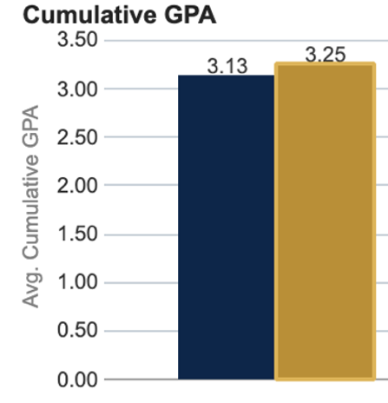
Background
A course on “Business Analytics” which is a core course for the undergraduate BA in Business Administration degree
A course with historically high percentage of DFW rates which improved significantly with different student success initiatives like Supplemental Instruction (SI) and mentoring over the past few years
Focused on two sections offered in Spring 2023 – both using an asynchronous online format
At the beginning of the semester, a snapshot of the students’ academic background can be reviewed on FSSD (right) so that the instructor can prepare accordingly
Notes:
Students’ average cumulative GPA at the beginning of the course in Spring 2023

Slide 3
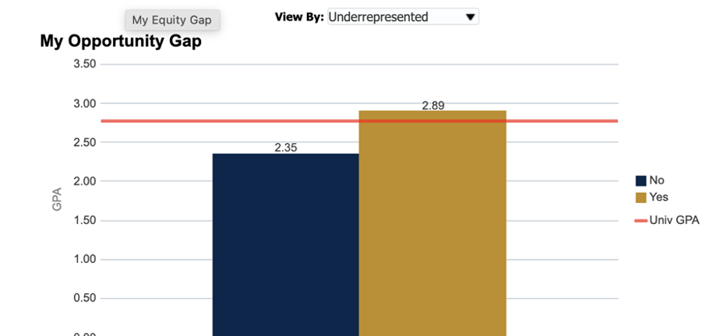
Achievement gap
Next, I tried to determine if there existed an “achievement gap” in the course in prior semesters (Fall 2022 course, for example) via FSSD
Average course GPA was 2.89 for UR students and 2.35 for non-UR students
UR GPA was slightly better than university GPA as well
Hence the need to boost overall course performance (all students)
Notes:
The GPAs for different sub-groups can help instructors understand whether specific attention is needed for underserved students, so that suitable steps may be taken as mitigation measures. If not needed, the focus can be on overall improvements for all students.

Slide 4
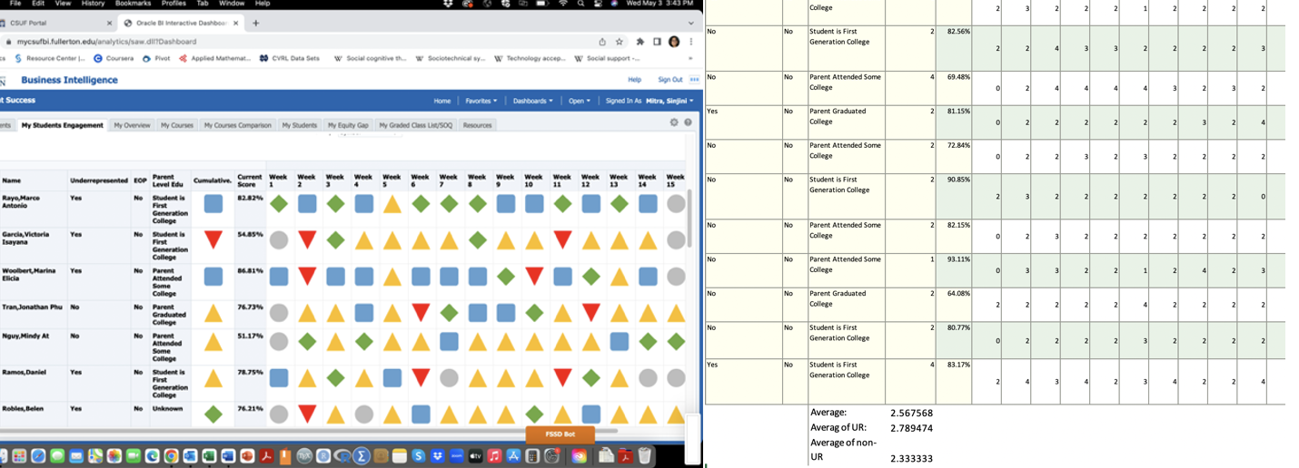
Student engagement data
Student engagement data in FSSD is a great way to understand to what extent students are interacting with the course materials on Canvas
Lecture slides, lecture and supplementary videos, assessments
This is especially important for fully online classes
The “symbolic” data (left) quickly helped identify students with low engagement and summary statistics (average, median) can be calculated using the “numeric” data (right)
These data showed the need to monitor student engagement regularly in future courses
Notes:
The average engagement scores were 2.54 and 2.33 for my 2 courses which were low for online courses (should be at least 3.0 in my opinion). I downloaded the Excel data files directly from the FSSD to do my computations. These can be calculated separately for UR and non-UR students in Excel as well, and I didn’t see a gap in the level of engagement between UR and non-UR students. I also started sending more frequent reminders to students about upcoming assignment deadlines.

Slide 5
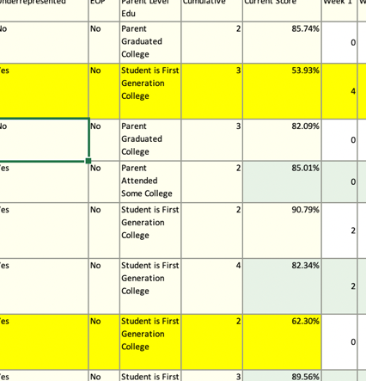
Identifying at-risk students
During the middle of the semester, I looked at student overall grades in my 2 courses
Helped me identify students whose progress was below par
These students were encouraged to reach out to me for additional help and support and to let me know if they were encountering any issues or challenges that were affecting their participation and progress
Most were first-generation students
Several students had reached out and sought help
Notes:
Students detected as low-performing are highlighted in yellow

Slide 6
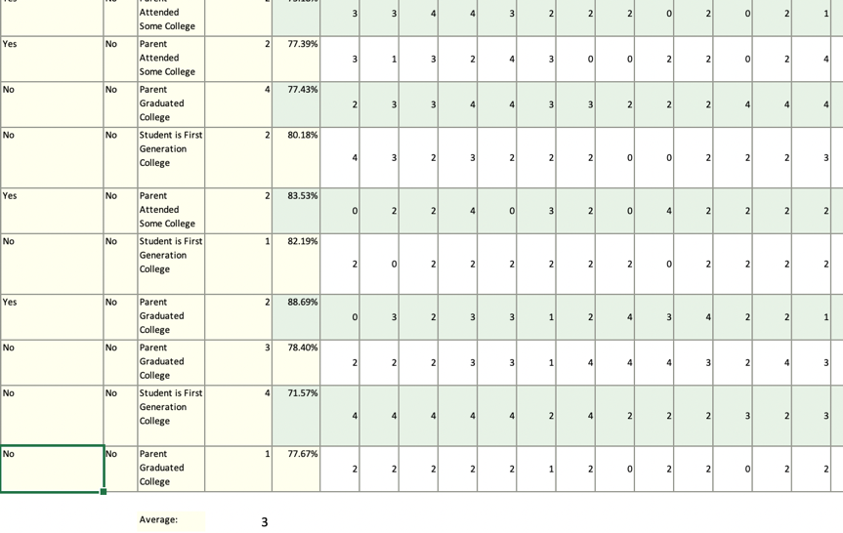
Final outcomes
Student engagement had improved to approximately 3.0 for both course sections at the end of Spring 2023
The average course GPA for both courses was 3.18 which was significantly higher than that from Fall 2022 semester (2.94)
Thus, both the continual monitoring of student performance and engagement data can help provide instructors valuable insights before, during, and after each semester to make course adjustments and modifications to further elevate the student learning process.
Future plan is to continue and expand the use of FSSD to my other courses and conduct additional research.
Thank you CSUF IT and FDC for the opportunity!

