Slide 1
PRESENTATION TITLE
DOCUMENTS, DOCUMENTS, AND MORE DOCUMENTS
Records Retention and Requests for Information
Anne Grogan
10/14/22

Slide 2
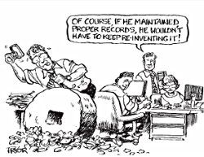
Records Retention and Management

Slide 3
What is a record?
A record is any document, in any format, used to engage in CSU business, regardless of media. This includes, but is not limited to:
Correspondence
Emails and attachments
Faxes
Instant Messages
Videos
Photographs
Audio Recordings
Content on mobile devices, laptops, desktops, websites, servers, databases, social media, etc.
Physical paper in files, such as memos, contracts, reports, and architectural drawings
Licenses, certificates, registration, identification cards, etc.
A record is not:
a duplicate or convenience copy or a draft

Slide 4
Types of Records
Vital - ensure operational continuity for the campus after a disruption or disaster (can be operational, legal, historical, or fiscal).
Operational - required by a campus/department to perform its primary function.
Legal - Required to be kept by law or may be needed for litigation or a government investigation.
Fiscal - Related to the financial transactions of the campus, especially those required for audit or tax purposes.
Historical - Historical records are of long-term value in documenting past events.
Archival - Archival records are any of the above records with permanent value. They should be transferred to the University Archives at end of their retention period.

Slide 5
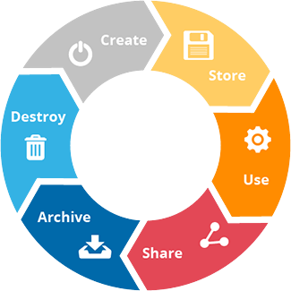
Life Cycle of a Record

Slide 6
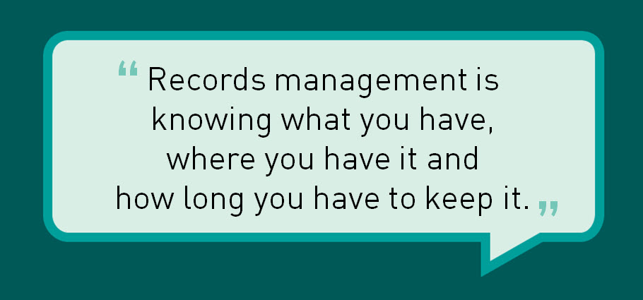
Record retention and management is the maintenance of records for a prescribed period of time, which is called the retention period.
CSU Records Retention Schedule
Lists and governs the retention period of records that are common across the CSU.

Slide 7
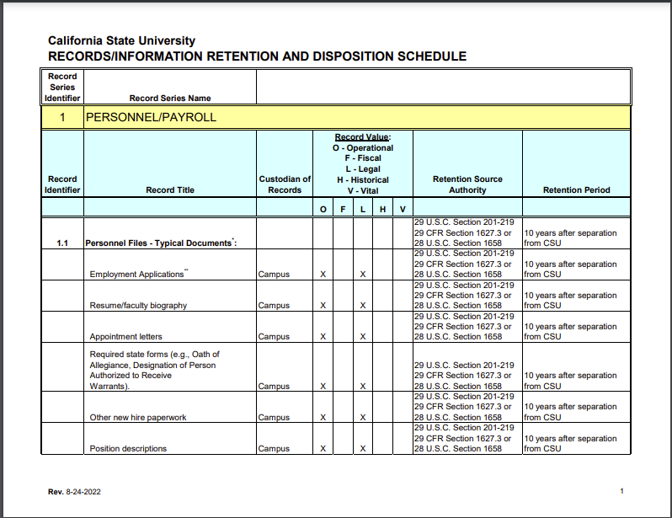

Slide 8
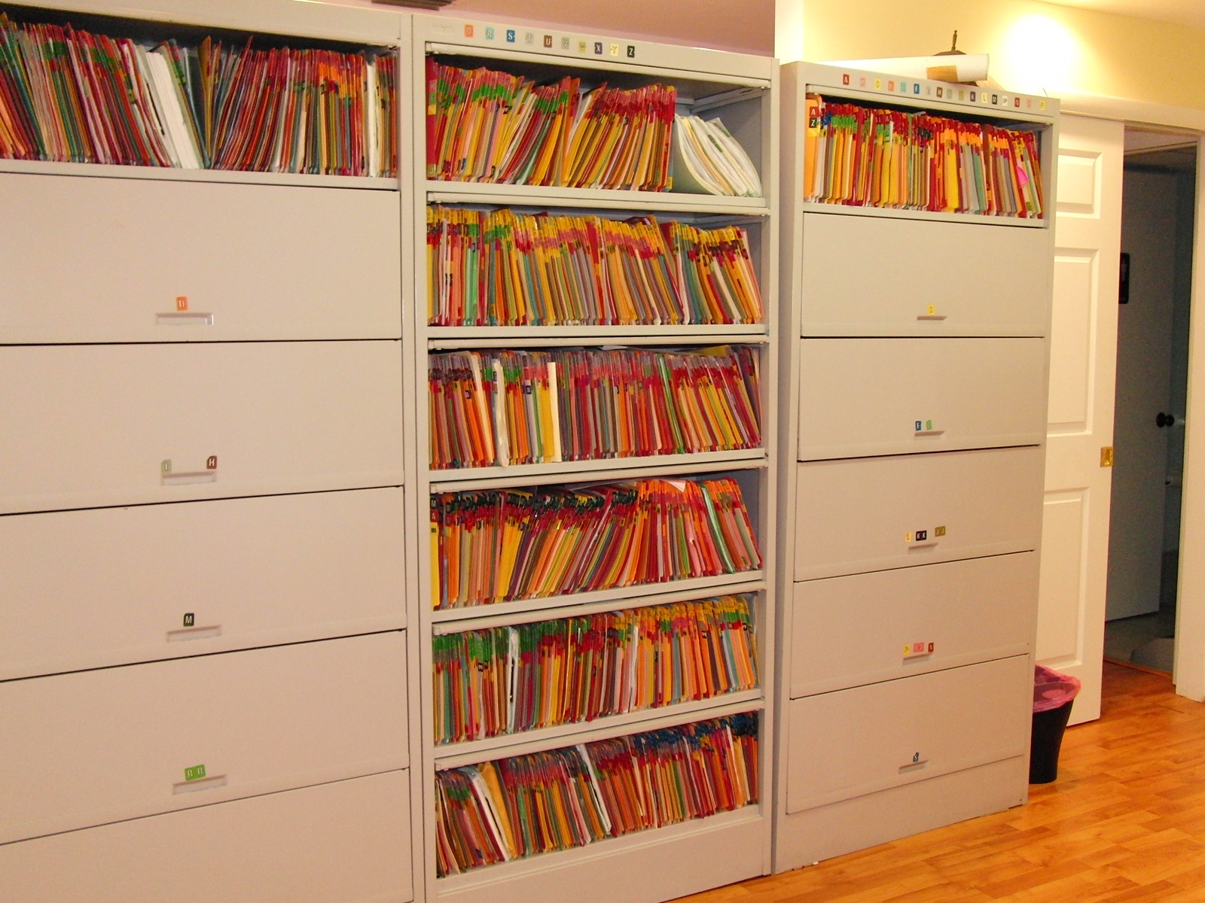
Authority
Executive Order 1031 and President’s Directive 20 direct the campus to create and implement a policy for Records/Information Retention and Disposition
Objective
Compliance with legal and regulatory requirements.
Implement operational practices and processes to properly and securely manage, replace, dispose of, preserve, and/or archive records.

Slide 9
Benefits
Improves office efficiency
Facilitates access to records
Ensures consistency
Decreases operational costs
Increases staff productivity
Assists the University in meeting legal and regulatory standards
Obsolete records impede access to current records; pose a possible legal liability, and waste valuable space.

Slide 11
Responsibilities
Retain records for the time indicated in records retention and disposition schedules; destroy the records when the retention period has been met; and dispose of records per University standards.
University Information Security Officer
Campus Managers
Records Custodians/Coordinators
Campus Users - Collect, use, maintain, and release records
according to CSU and campus policies, standards, and
procedures.

Slide 12
Disposal
Retention periods are typically counted from the date of creation of the record and disposal typically occurs following the end of the year that marks the end of the retention period.
Information/records classified at Level 3 can be disposed of via normal waste disposal practices.
Level 1 and Level 2 information must be destroyed securely.
Failure to properly dispose of records can lead to unnecessary expense and subject the records to possible future requests under statute or legal proceedings.

Slide 13
Sometimes, records should not be destroyed even if they have reached or exceeded their retention period:
State and federal laws or regulation
University grants or contracts override university retention periods Records that have been requested pursuant to statute or legal proceeding
Records that are deemed likely to be requested
Investigation Records

Slide 14
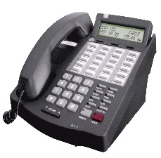
ASK YOURSELF:
1. Are you the custodian?
2. Is the record on a legal
hold or subject to any
other retention
requirements?
3. Does the record provide
any benefit to me?
Build time into your calendar in December and January to manage your records.
Don’t create unnecessary records.
Make phone calls.
Questions – email or call Risk Management
Anne Grogan – x5465, agrogan@Fullerton.edu
John Beisner – x4937, jbeisner@Fullerton.edu
Be thoughtful about email.
Manage ‘sent’ and ‘deleted’ item folders.
Use resources to gain control of your inbox.

Slide 15
RESOURCES
https://www.mindtools.com/pages/article/newHTE_85.htm
https://www.investintech.com/resources/blog/archives/5525-document-management.html
https://www.liveabout.com/computer-file-management-tips-2948083
LinkedIn Learning
Outlook: Efficient Email Management
How to Get (and Stay) On Top of Your Inbox

Slide 16
Questions?

