Slide 1
NRCAL Summer Institute 2017
California State University, Fullerton
“The Role of Parents and Community in Shaping Language Programs”
Mercedes Ibarra, CABE PDS Consultant

Slide 2
Today’s Outcomes
We will identify ways parents can contribute and be part of a multicultural environment in and out of the classroom.
We will describe approaches to build community with parents and families in a language program.

Slide 3
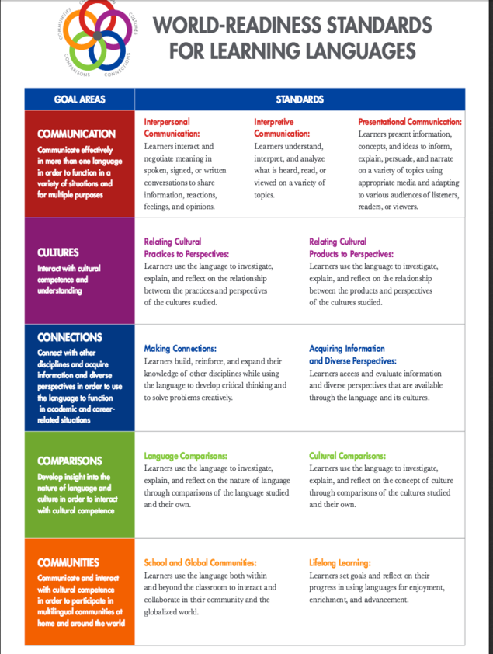
World Language Standards

Slide 4
Cultures
Interact with cultural competence and understanding
Relating cultural practices to perspectives
Relating cultural products to perspectives

Slide 5
Comparisons
Develop insight into the nature of language and culture in order to interact with cultural competence
...through comparisons of target language and their own language
...through comparisons of cultures studies and their own

Slide 6
Communities
Communicate and interact with cultural competence in order to participate in multilingual communities at home and around the world

Slide 7
The 3 Pillars of DL Education

Slide 8
Guiding Principles for Dual Language Education
www.cal.org/twi

Slide 9
Guiding Principles for Dual Language Education
Research Review of 7 Strands
1 - Assessment and Accountability
2 – Curriculum
3 – Instruction
4 – Staff Quality
5 – Program Structure
6 – Family and Community
7 – Support and Resources
Guiding Principles in each strand
Key descriptors
Grounded in evidence from research/best practices
http://www.lindholm-leary.com/resources/review_research.pdf

Slide 10
Strand 5: Program
Principle 1
“all aspects of the program work together to achieve the goals of additive bilingualism, biliteracy, and cross-cultural competence, while meeting grade level expectations”
Principle 2
“Equity across all groups”

Slide 11
Strand 6 Family & Community
Principle 1 : “Responsive infrastructure for positive, active, and ongoing relations with students’ families and the community”
Principle 2: “Parent education and support services that are reflective of the bilingual and multicultural goals of the program”
Principle 3: “views and involves parents and community as strategic partners”

Slide 12
At the School Site
Banners and signs in program languages
School environmental print in program languages
Rules
Calendars
Messages
Bilingual parent meetings (including committees) and workshops

Slide 13
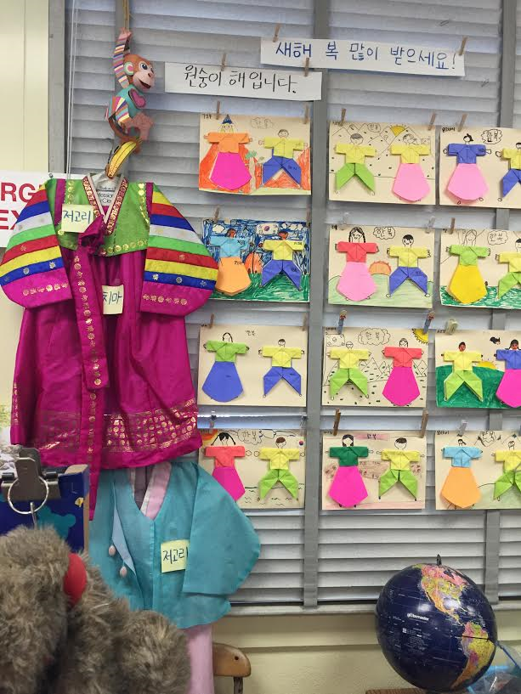
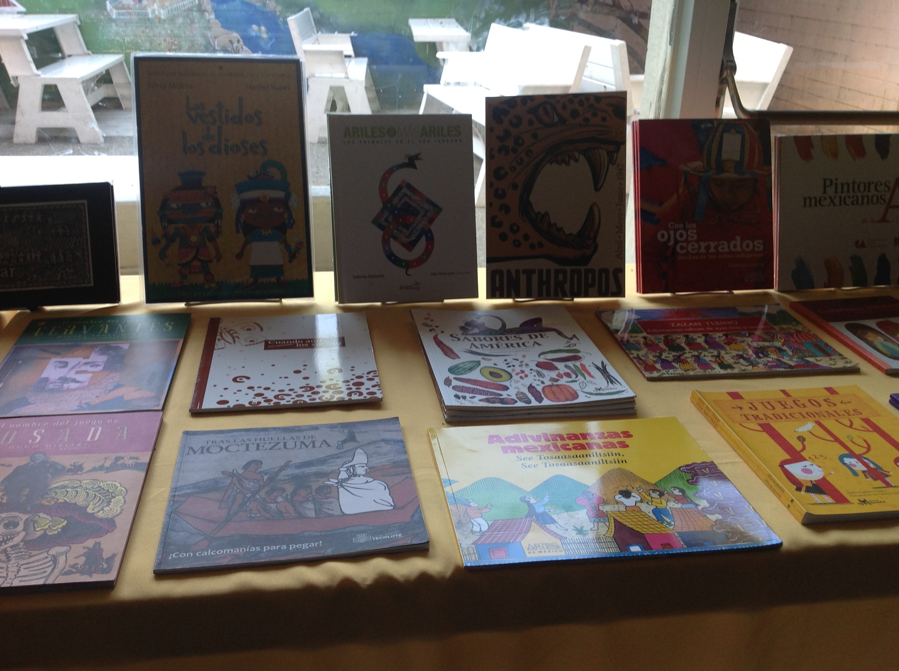
Classroom Environment
Visuals of multicultural historical figures and cultural artifacts are displayed
Posters
Literature
Musical instruments
Maps
Art

Slide 14
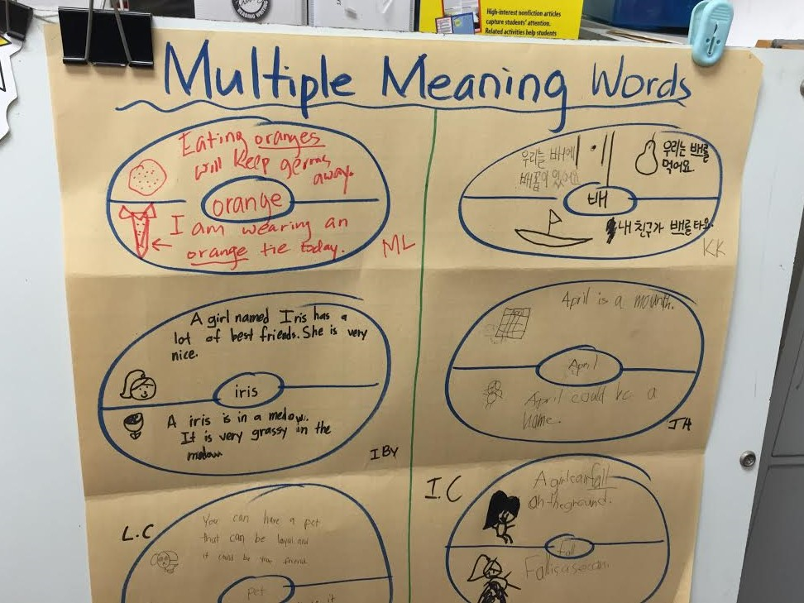
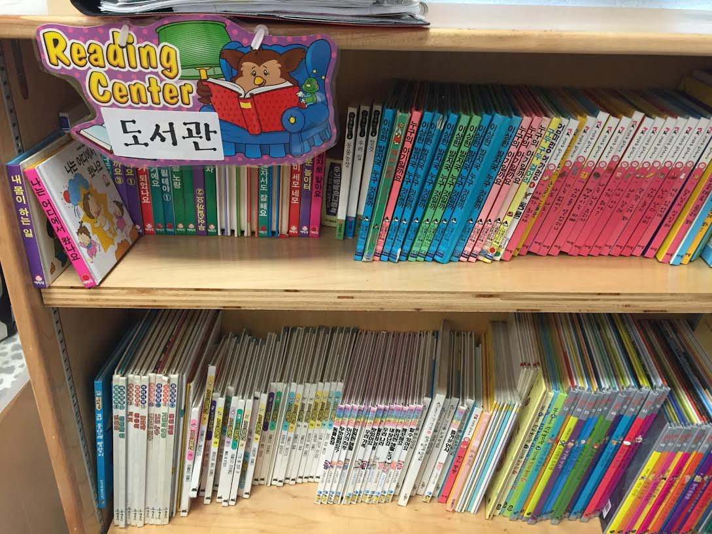
Classroom Environmental Print
Labels in the designated language
Student work displayed and labeled

Slide 15
Turn and Talk
What are some ways you can give the target language status in your classroom and in your school?
Turn and talk to your neighbor.

Slide 16
Benefits of Being Bilingual
Many educators also prefer dual language programs when it comes to teaching children who are learning English, not only because it keeps them connected to their culture but also because if you stop teaching them subjects like math that require more abstract thought and just focus on teaching English, they lose out on "critical time" for cognitive development.
https://www.dnainfo.com/new-york/20141117/upper-west-side/what-you-need-know-before-sending-your-child-dual-language-program

Slide 17
Culture in the Classroom
What are the benefits of learning about other cultures?
How do students benefit from interacting with other cultures?
Turn and talk to your neighbor.

Slide 18
Parent Expectations
What are some expectations parents have from their children regarding culture?
Dress (religion)
Language
Patriotism
Manners
Respect for elders

Slide 19
Culture in the Home
What advice can we give parents to promote the students’ interaction with cultures in and out of the classroom?
Turn and talk to your neighbor.

Slide 20
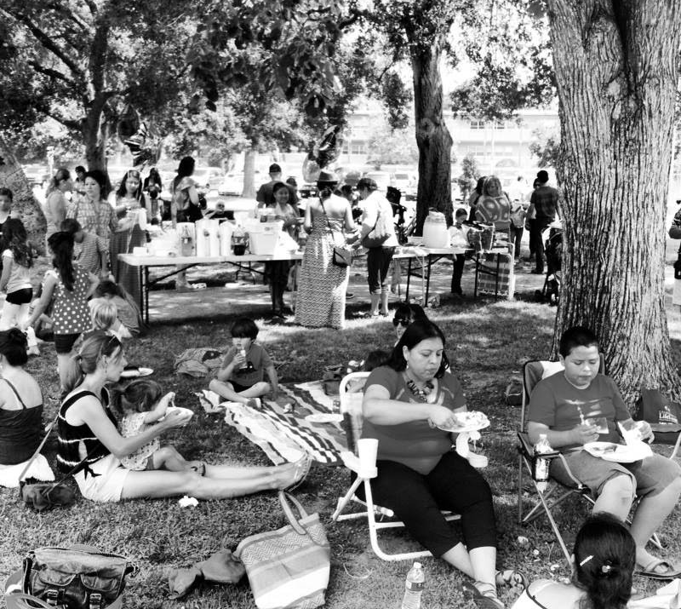
Parent Support/Network
Promote fellowship and communication through activities
Home visits
Potlucks
Coffees
Playgroups/Playdates
Email listserv, Facebook page

Slide 21
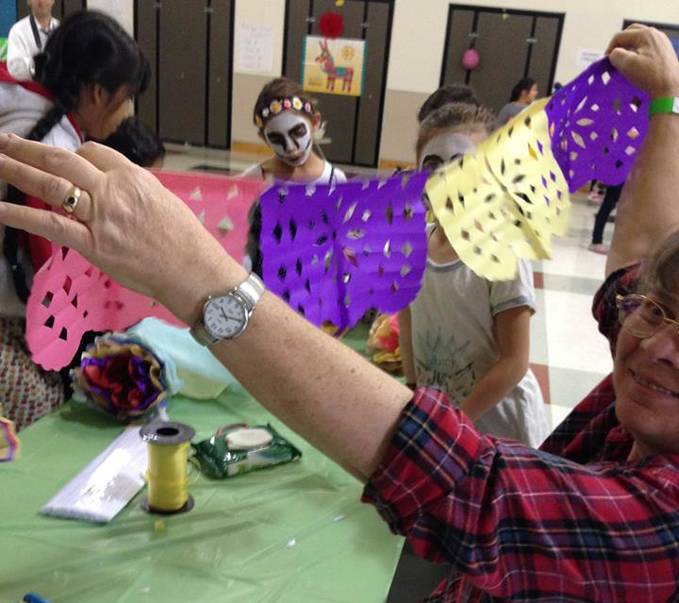
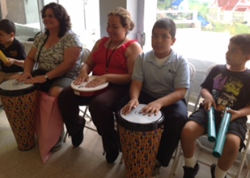
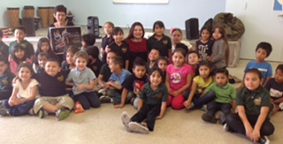
Cultural Experiences for Families
Hands-on activities and celebrations
Holidays and traditions
Arts and crafts
Cooking workshops
Game nights
Celebrate other cultures, too!
Author/Artist Visits
Concerts, Music Workshops
Notes:
Japanese Girls Day and Boys Day
Origami
Tangrams

Slide 22
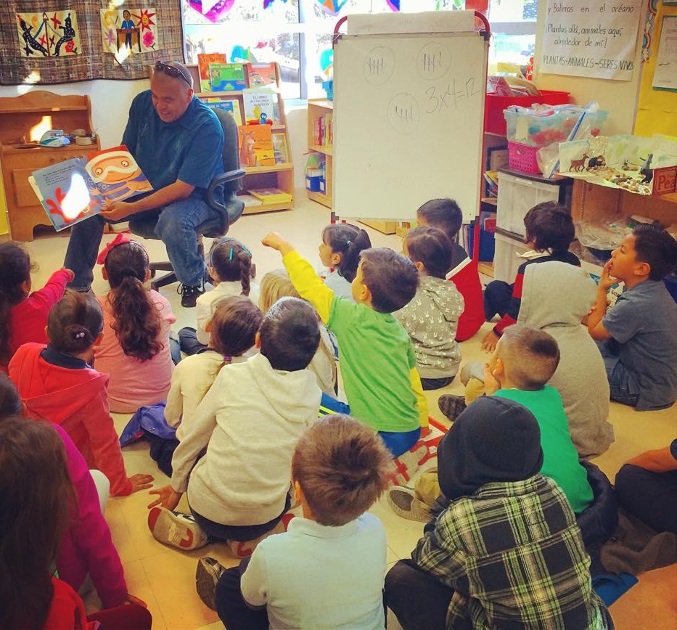
Parent Engagement
Helping in the Classroom
Invite target language-speaking parents to help during target language time/English-speaking parents during English time
Tutoring 1:1
Assist in science lab or with art activities
Supervision on the yard or in the classroom
Storytelling, read aloud

Slide 23
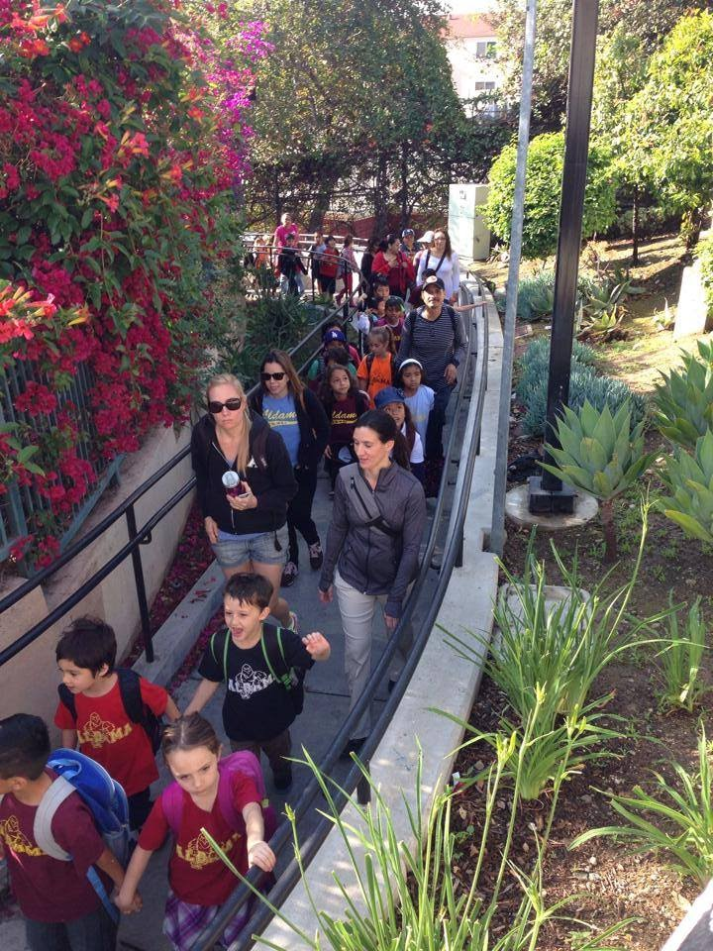
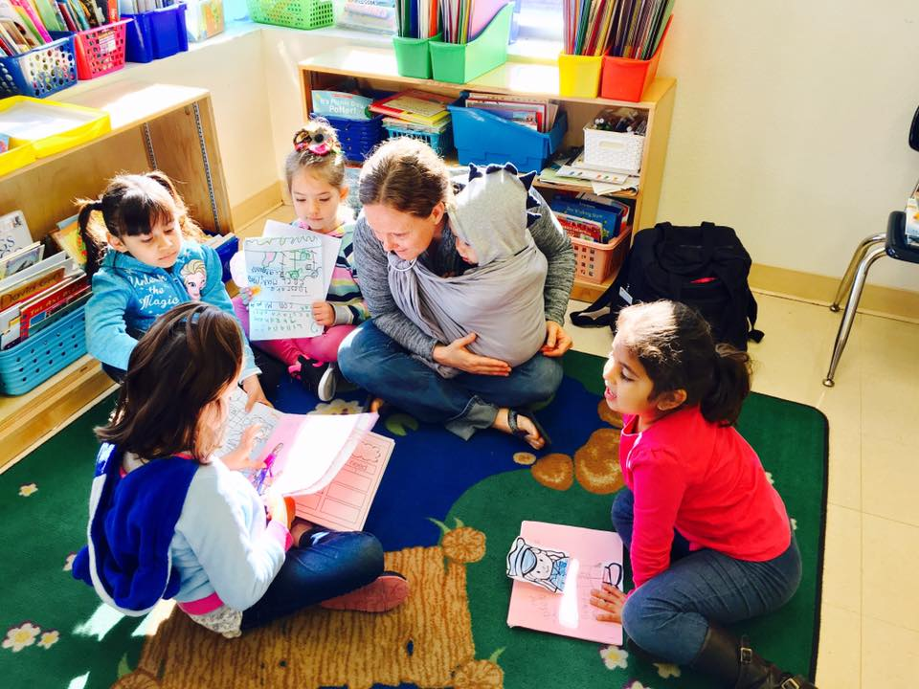
Parents in the Classroom
Presentations (career, historical events)
Teaching a dance, song, or art activity
Planning celebrations and special events
Audience for student presentations
Field trip chaperones

Slide 24
Homework Help
Help for students
Provide directions in English for parents
At “Back to School Night,” promote bilingual buddies
After school or before school tutoring/homework help
Collaborate with after school program
Stipend for staff
Parent volunteers
Local community resources (recreation centers, libraries, universities, city colleges)
Notes:
How to help student with homework in target language
§ Always provide translated directions for parents
§ At BTSN promote bilingual buddies and provide time for exchange of personal information, i.e., phone number or email
§ Consider after school or before school tutor/homework help
· Find stipend for staff
o · Seek parent volunteer
· Reach out to local community resources (recreation centers, libraries, universities, city colleges)

Slide 25
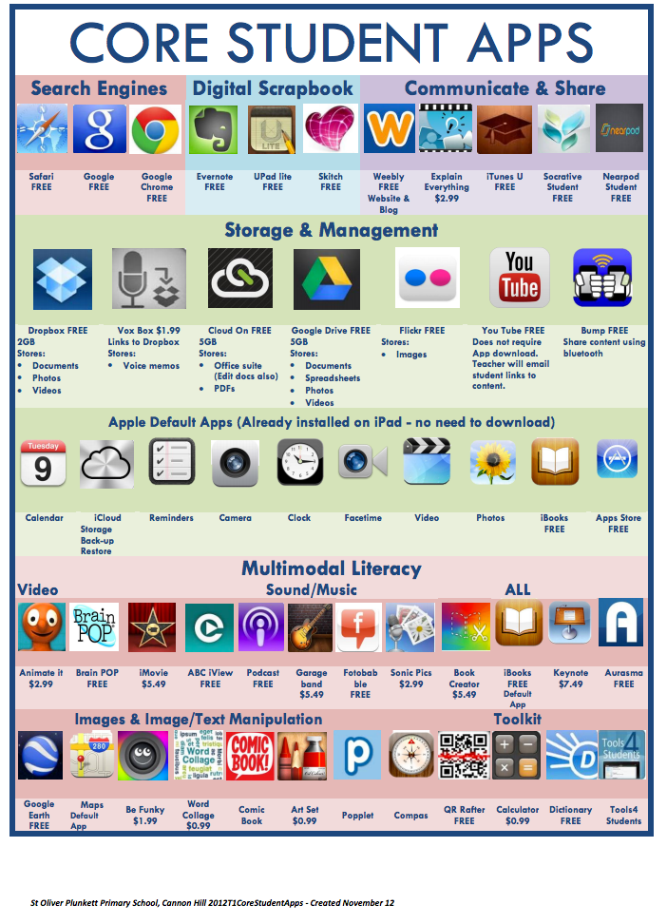
Resources for Parents
Provide technological resources to support with language (websites, Google docs, apps, programs)
Provide support through parent workshops led by DI teachers

Slide 26
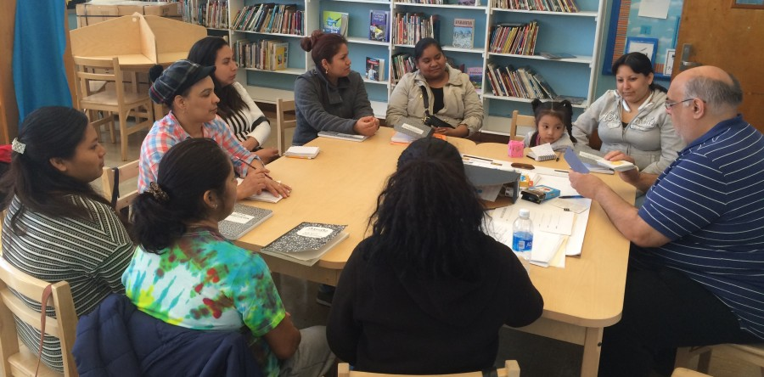
Parent Workshops/Meetings
Grade-level meetings to discuss content and skills development
Language Program Topics
Language acquisition
Cultural competency activities
Research on student achievement in DI
Brain research

Slide 27
Thank You!
Mercedes Ibarra
For more information, contact us at
CABEPDS@bilingualeducation.org
(626) 814-4441, ext. 212

