Slide 1
Federal Work-Study Training for On-Campus Employers
2025 - 2026

Slide 2
HOUSEKEEPING
Questions may be asked during the presentation or afterward. Feel free to unmute.
Some questions might be best answered offline for the sake of time. To promote time management, I will make a recommendation if needed.
Policy and processes discussed today may include those of Finance, Payroll and HRDI. Questions on these items should be directed to each respective department.
This training will count towards the hiring requirement if you stay on throughout the entire length of the content portion. If you log out early, it will not count as attending.

Slide 3

AGENDA
Review Recent Updates to FWS
Definitions
Commitments from Employers
Changes for this Award Year
Federal Work-Study and Awards
FWS Allocation and Matching Funds
FWS Hiring Process
Tracking Hours/Awards
Questions

Slide 4
Recent FWS Updates
Appointment Dates for Academic Year
  FWS GAs 2326
    these are monthly appointments
    end date needs to reflect end of award & pay period
  ISAs 1151 & SAs 1861/1872 for non-graduating students
    AY will be 8/18/25 – 5/15/26
    Will be updating website with new dates
Eligibility
  Over 17,000 students have been offered FWS (includes students who had FWS last year, incoming freshmen, & transfer students) & there are about 400 jobs on campus
  Continuing students who were offered FWS last year, but did not get hired/paid in FWS will not be automatically offered FWS. I can make an exception if they still meet the requirements of FWS.
  Depts should be asking students for screenshots of FWS award with 25-26 AY dates. Before asking the FWS Counselor if a student qualifies for FWS, please check with the student to see if FWS is on their financial awards.
    Once new CMS access is granted, depts will be able to look up if a student was offered FWS
Summer ’25
  Due to SAs being unionized, FWS did not run in July. Any student working in July should have been paid with department funds.
Rehires/Concurrent Appointments
  Please complete the FWS Reappointment Form
    Refer to the Dates of Employment

Slide 5
Definitions
Academic FWS student:
  Instructional Student Assistant (ISA-1151)
  Graduate Assistant (GA-2326)
Non-Academic FWS student:
  Student Assistant (SA-1861)
  Off Campus (SA-1872)
  Bridge Student Assistant (SA-1875)
Hire/Appoint
  Those that get processed through CHRS Recruiting
  They either have never worked on campus in a state side position or did work over a year ago and need to redo hiring paperwork
Rehire/Reappoint/Concurrent
  Those that get processed through the FWS Reappointment Form or Temporary Academic Employment (TAE)
  Have worked in a state side position within the last 12 months and do not need to complete hiring paperwork
Offered FWS Award
  Students will first have an OFFERED award.
  This means they have not been placed in a FWS position yet
Accepted FWS Award
  FWS award changes to ACCEPTED when the FWS Counselor approves the hire and accepts the award on the student’s behalf

Slide 6
Definitions Continued
Continuing students
  Typically Freshmen, Sophomore, or Junior students who plan on returning to CSUF the following year
  Important to know so you hire the student with the correct end dates
Graduating students
  Students in Senior status and have confirmed their graduation date with Admissions
  Important to know so you hire the student with the correct end dates

Slide 7
COMMITMENTS FROM EMPLOYERS
  At least one person from the employing department will attend a Federal Work-Study training session to ensure that policy and procedure are communicated (attendance is required for only 1 training session each AY)
  Employers will communicate any changes in employer staffing to the Federal Work-Study Counselor to ensure e-mails/updates are provided to the appropriate staff/managers.
  FWS student hires will also be appointed in non-FWS positions to support them when they have earned their entire FWS award
  For all reappointed FWS student hires, the employing department will submit the On-Campus Reappointment Authorization Form
  Once an FWS student has reached their award, employers will terminate their FWS position with Payroll
  Employers will effectively track the FWS awards of their employees to prevent exceeding the awards of students
  If students exceed their FWS awards, the department will complete a Payroll Expenditure Transfer in a timely manner to reimburse the FWS program
  As a courtesy notice, the Office of Financial Aid wants to convey to employers that departments must respond to/comply with communications from the Office of Financial Aid regarding overawards and Payroll Expenditure Transfers (PETs) in a timely manner. Our office asks that employers please understand that failure to support these communications jeopardizes our program’s compliance with federal regulations and it places the FWS allocation for our campus at risk. Employers that do not comply with these communications will risk their future participation in the FWS program.

Slide 8

CHANGES FOR THIS AWARD YEAR
Reappointing
  New form is coming! SOON
  Form will need to be completed for ALL FWS Reappointed students
  FWS will be part of the workflow in TAE for academic students
New FWS CMS access
  Depts will be able to check if students have FWS offered in PeopleSoft!
    Your VP/Dean’s Office was asked to provide a list of staff who would need this access
    Once CMS finalizes access, email will be sent out regarding training
FWS Appeal Request
  https://fullerton.qualtrics.com/jfe/form/SV_cBGFXgzq0bvhQzQ
  If a student you hired was not offered FWS, and they want to inquire about it, they can submit an appeal

Slide 9
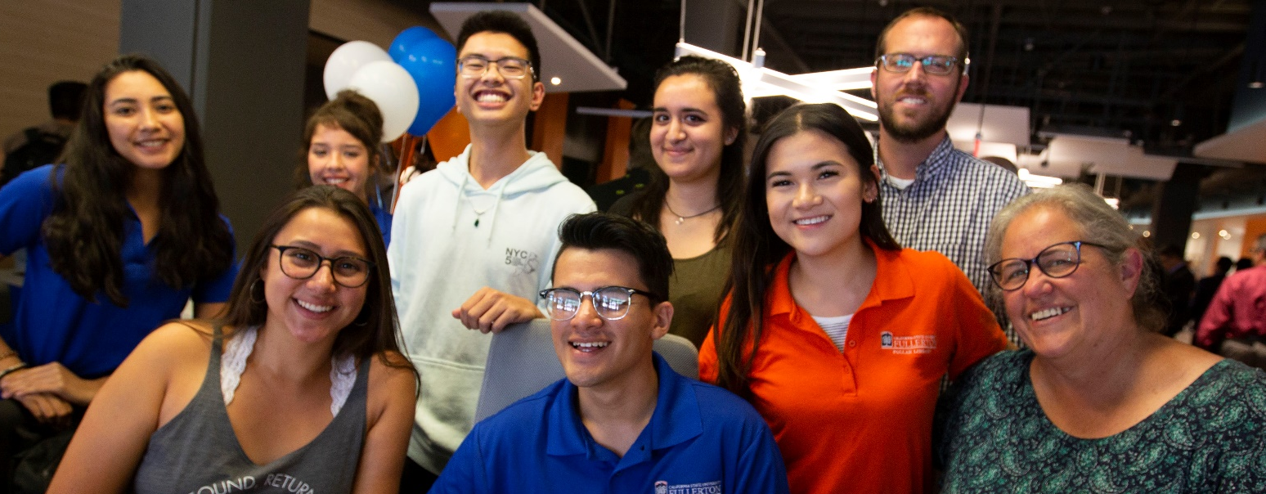
FEDERAL WORK-STUDY AND AWARDS
The Federal Work-Study (FWS) program provides part-time jobs for undergraduates and graduate students with financial need, allowing them to earn money to help pay education expenses. The program encourages community service and work related to the student's course of study. This program is coordinated by the Department of Education.
  On-campus and Off-campus FWS job opportunities
  Student Assistant, Instructional Student Assistant (Unit 11), and Graduate Assistants (Unit 11) positions

Slide 10
FWS & Awards Continued
The FWS Award amount is not set in stone; it can increase or decrease throughout the AY
Cases it decreases:
  Middle Class Scholarship (usually awarded in Nov)
  Student earns a scholarship
Cases it increases:
  Typically beginning of Spring, if there is still FWS money to be used, FWS Counselor will announce increase appeal from depts
  If there was a rollover from previous year
It is the responsibility of the dept to check in with the student to confirm FWS award hasn’t changed
  Once the CMS access is created, depts will be able to look up student FWS awards

Slide 11
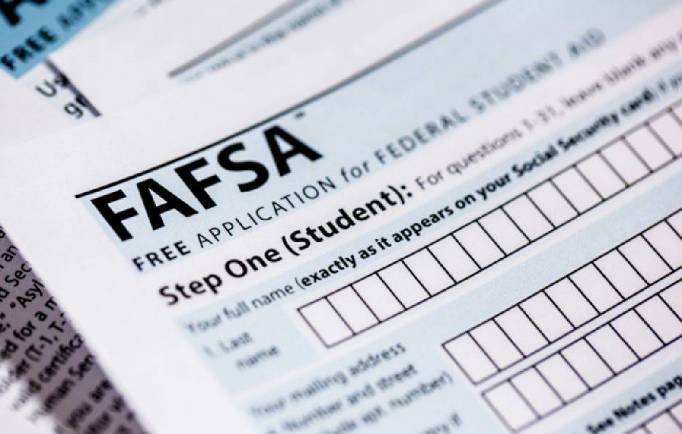
FEDERAL WORK-STUDY AND AWARDS
Eligibility for FWS:
Complete the FAFSA by April 2nd
Question 31 on the FAFSA, “Are you interested in being considered for work-study?” was removed.
  Continuing students who worked in a FWS position last year
  Incoming new students who meet criteria
Submit all requested financial aid documentation from their To-Do/Task List by the due date
Maintain Satisfactory Academic Progress (SAP)
Enrolled in at least half-time units each semester (exception during summer)
Must have Federal Need as determined by Federal Guidelines
SAI of 5000 or less (this number is populated from the data provided on the FAFSA)
If a student received FWS during their career, they are eligible for FWS

Slide 12
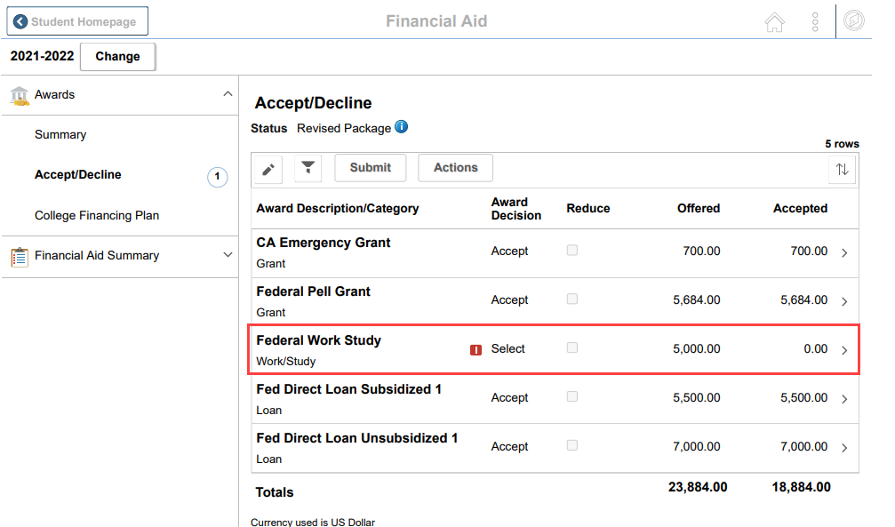
FEDERAL WORK-STUDY AND AWARDS
FWS Offer
FWS is currently granted on a first-come-first-served-basis. More students are “offered” FWS awards than the program has funds to support. This process is utilized to ensure our campus uses the full allocation of FWS funds
Employers can ask for a screenshot of candidate FWS awards during the hiring process

Slide 13

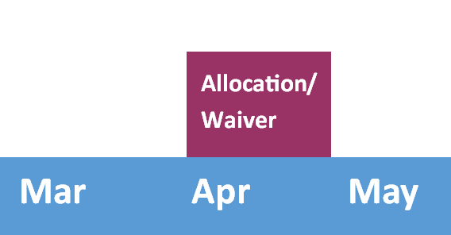
FWS ALLOCATION AND MATCHING FUNDS
The Federal Work-Study year begins with the allocation for Cal State Fullerton being available within the Common Origination and Disbursement (COD) system. This typically happens in April. Our campus may also be awarded a waiver of the matching requirement at this time.

Slide 14
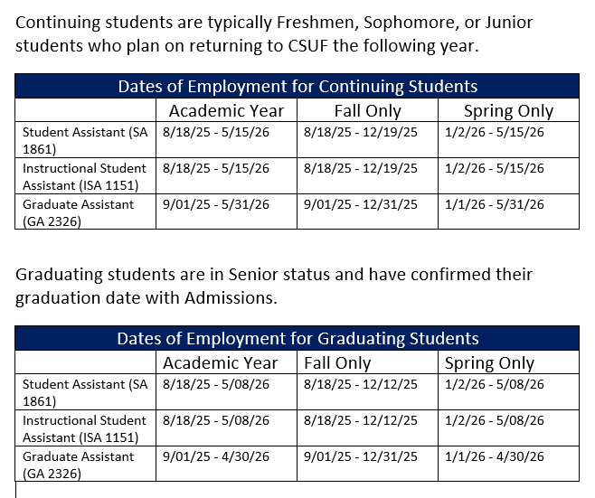
FWS Dates of Employment

Slide 15
FWS ALLOCATION AND MATCHING FUNDS
Eligibility Waiver of Non-Federal Share Matching Requirement
Cal State Fullerton has been granted the ability to reimburse FWS positions at 100%. This is due to CSUF being identified as each of the following:
Asian American and Native American Pacific Islander – Serving Institution
Developing Hispanic – Serving Institution
Promoting Postbaccalaureate Opportunities for Hispanic Americans
Percentage of FWS Salaries Paid
25%
100%
75%
Employer
Federal Work-Study

Slide 16
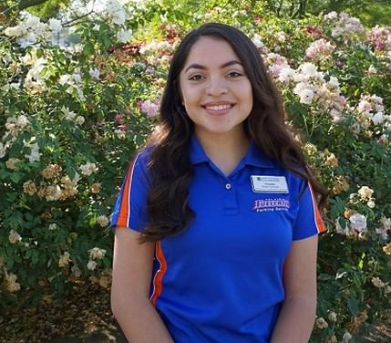
FWS ALLOCATION AND MATCHING FUNDS
Eligibility Waiver of Non-Federal Share Matching Requirement
2018-2019
Matching Requirement
2019-Present
Waiver of Matching Requirement
Example:
Example:
Denise has a $5,000 FWS award
$1,250 is paid by the employer
$3,750 is paid by Federal Work-Study
Denise has a $5,000 FWS award
    $5,000 is paid by Federal Work-Study

Slide 17
FWS HIRING Process –
Appointment Dates
FWS Summer appointments begin 7/1 (normally)
  Any student working in June should be paid by the dept and hired into a dept funded position
  July and August FWS earnings come from the new, upcoming academic year’s FWS award
For summer, the job code will be based on unit enrollment
  1875/1876 – 0-5 units enrollment (during summer only)
  1861/1872 – 6 units or more enrollment
HR is recommending that all Fall Student Assistant appointments be made as Academic Year (Fall and Spring)
Graduating students can work up to the last day of classes in the semester
FWS GA appointments must have an end date that is close to the date the award ends. Hiring dept will work with OFA Counselor before creating appointment

Slide 18
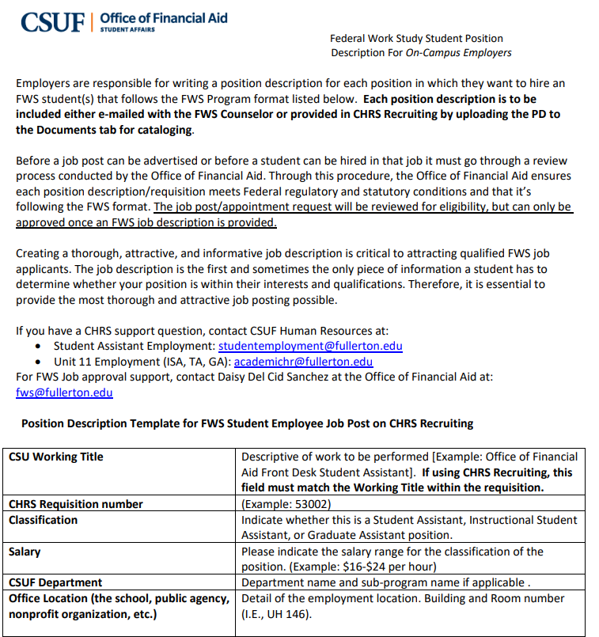
FWS HIRING Process
Annual Job Description
Each year all employers must send a completed Job Description for each FWS position to the FWS Coordinator before the employer can post FWS positions, or hire FWS students.

Slide 19
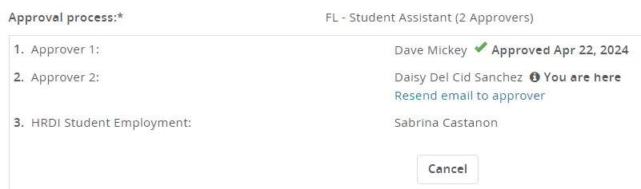
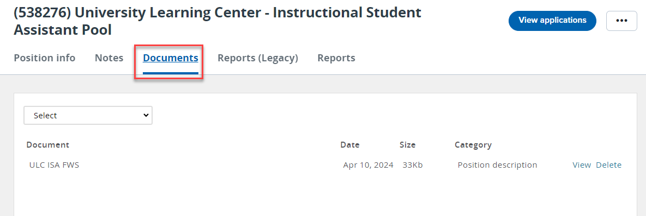
FWS HIRING PROCESS
To prevent issues in overawards and time reporting, employers are asked to also reappoint FWS students in department-paid roles after the initial appointment is completed.
New Hires
Both academic and non-academic FWS new hires are initially appointed in CHRS Recruiting
These are all the students who have never worked in a state side position within the last 12 months.
FWS must be an approver on the requisition and offer card
When creating a new req, please include the FWS job description in the Documents tab

Slide 20
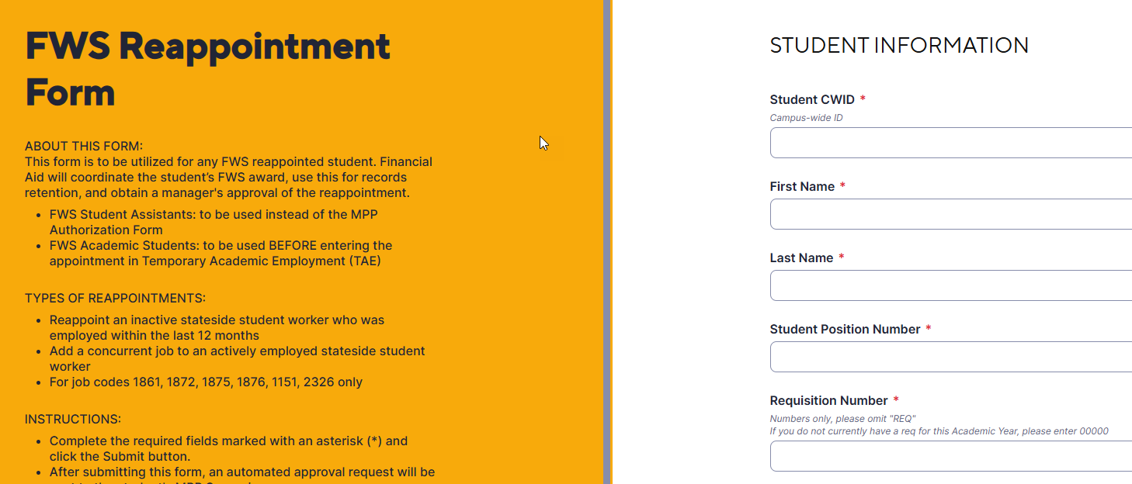
FWS STUDENT ASSISTANT HIRING PROCESS
Reappointments
Student Assistants (SA)
Depts must complete the FWS Reappointment Form
The FWS Reappointment Form “talks to” the MPP Approval Form
Ensure you know the Requisition number before you get started
Submitter will enter the information needed, the Supervisor will approve, the FWS Counselor will approve/deny, & dept receives confirmation
If the dept wants to give an increase to a FWS student AFTER being hired, the dept will need to complete the MPP Approval Form

Slide 21
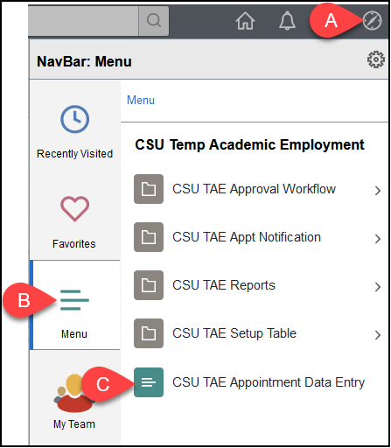
FWS HIRING PROCESS
Reappointments
Academic FWS Students (ISA/GA)
TAE
Depts must complete the FWS Reappointment Form
Once approved by the FWS Counselor, you will receive an email with confirmation
Academic student hires are reappointed in TAE. Please follow HRDI’s instructions regarding the reappointment process
FWS will be an approver in TAE. More info to come!

Slide 22
FWS HIRING PROCESS
Reappointment Example
Term | Fall | Spring
Situation | Suzy Titan was hired as an ISA (1150) within a college for the Fall term. | The employer became aware that Suzy was eligible for an FWS award. Suzy Titan was rehired for the Spring term as an FWS ISA (1151).
Hiring System | This hire was processed within CHRS Recruiting. Financial Aid did not need to be included as an approver on Suzy’s offer card, as this was a regular ISA job. The employer also utilized TAE to process the contract | This hire was processed when the student was active. Hiring policy states that this hire does not need to be processed in CHRS Recruiting, and may be processed within TAE alone.
Financial Aid Involvement | None, as this is not a FWS position | A FWS Reappointment form must be submitted to ensure the student meets FWS criteria and to coordinate the student’s FWS award.

Slide 23

TRACKING FWS AWARDS
The Federal Student Aid Handbook states that the FWS student in a given period may earn:
Summer: Up to 20% of their FWS Award
Fall: Up to 40% of their FWS Award (50% if hired in Fall)
Spring : Up to 40% of their FWS Award (50% if hired in Fall)

Slide 24
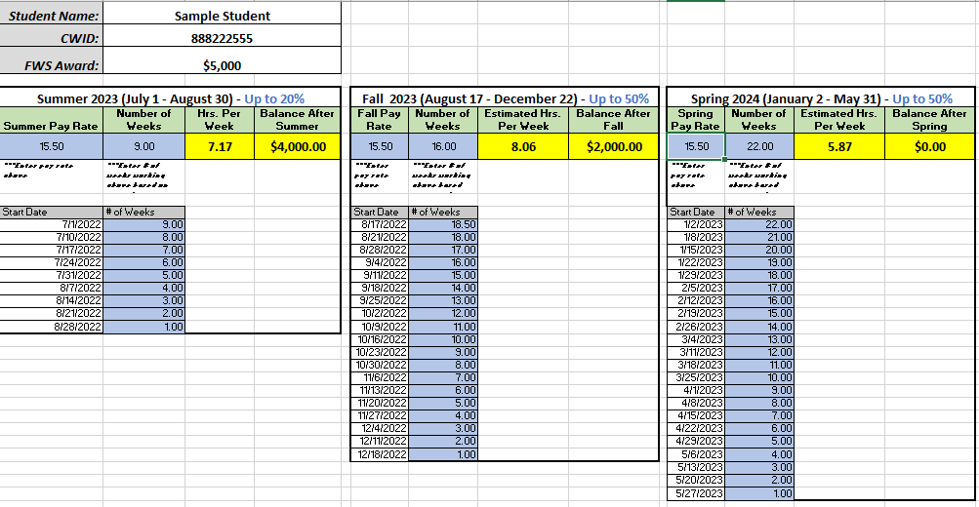
TRACKING FWS AWARDS
Estimate of Weekly FWS Hours
Employers should estimate the amount of hours that a student may work per week for their intended hiring period.
  Provide a realistic look at how long FWS awards will last
  The goal of the FWS program is to employ students through the Spring term (if applicable)
  Supervisors and Leads for FWS students should be included in these discussions

Slide 25
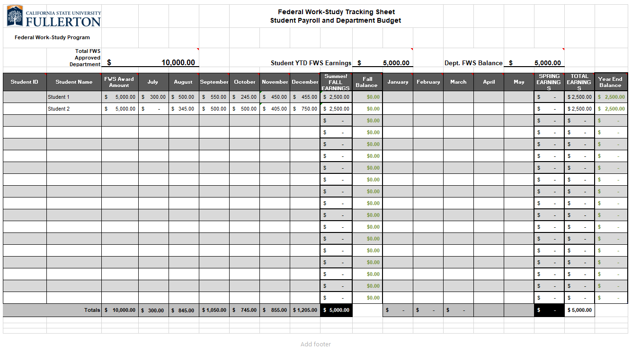
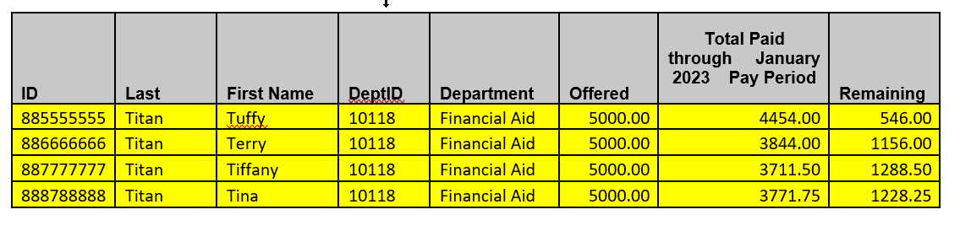
TRACKING FWS AWARDS
FWS Award Budget Tracking
The Office of Financial Aid asks that all FWS employers track their students’ wages each month to prevent over awards and anticipate when award limits will be reached
The Office of Financial Aid will provide monthly reports that share which students have a remaining balance of $2,000 or less*
These items are intended to be used together to predict when students will reach their allocation
Report provided in March for FWS earned through January 2023
*Based on the latest reports provided to Financial Aid

Slide 26
TRACKING FWS AWARDS
Students that Have Earned Allocation
Typically happens in the middle of a pay period. Departments should split hours between FWS position, and department-paid position for final FWS month.
Employers are asked to work with Payroll to terminate their FWS position after they have received their final FWS payment.
Example:
Tuffy Titan has earned 40 hours in the month. His pay rate is $15.50 and he has a remaining balance of $152.50 ($152.50/$15.50 = 9.8387 hours). The timekeeping system only understands tenths and not hundredths regarding hour entry, so I would allocate Tuffy’s 40 hours as follows:
Position | Hours | Total Paid (Hrs x Payrate)
FWS – Position | 9.8 hrs | 151.90 (.31 FWS Remaining)
Non-FWS Position | 30.2 | 468.10
Total | 40 | 620

Slide 27
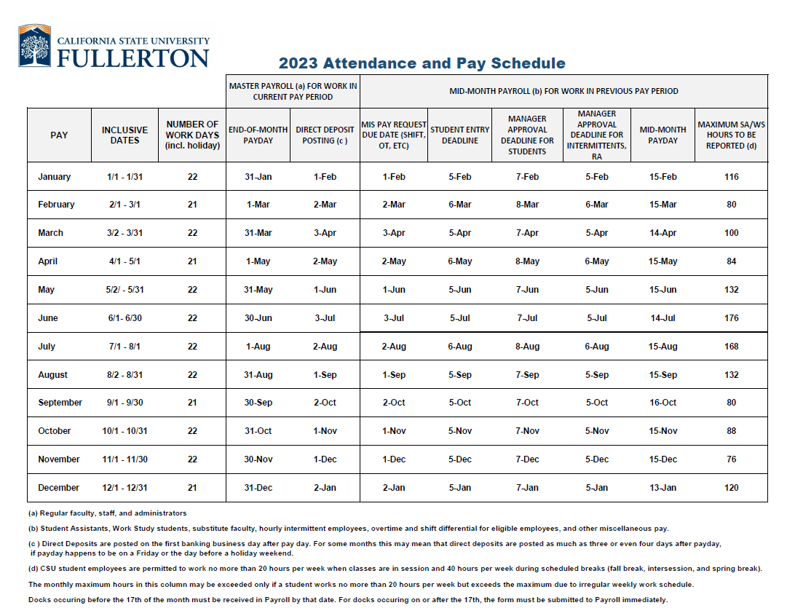
TRACKING FWS AWARDS
Additional Resources
CSUF Quick Reference Timekeeper Student Time Processing – guide shared by Payroll that shares a query “Reported Hrs-Student Workers” which can be used to look up hours for a student in a pay period
Attendance and Pay Schedule – Provides the exact dates that should be used for a pay period (best used with query above)
https://hr.fullerton.edu/payroll/employee-payroll/pay-calendars.php

Slide 28
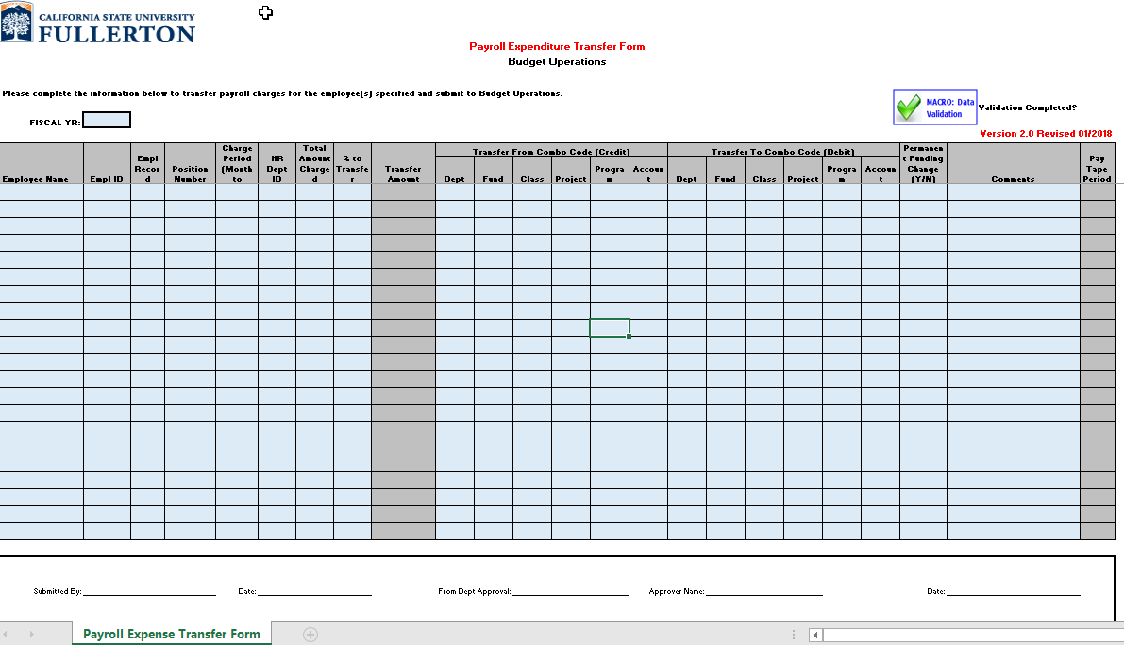
TRACKING FWS AWARDS
Over-Payments and Non-FWS Recipients
The FWS Coordinator tracks the amount a student has earned compared to the amount paid in wages.
If the student is almost out of wages the FWS Coordinator notifies the employer
If the student has earned more than was awarded, the employer is notified and must transfer the funds back to the FWS account via a Payroll Expenditure Transfer (PET)
If the student is not an FWS recipient, the employer is notified and must return the funds paid to the student with FWS funds

Slide 29

FWS Website: https://www.fullerton.edu/financialaid/understanding-aid/types-of-aid/fws/employers/index.html
Questions & Answers?
?

