Slide 1
Who am I?
Mikhail I. Gofman
Assistant Professor of Computer Science at CSUF since Fall 2012.
Education: Ph.D. in Computer Science at State University of New York at Binghamton.
Work experience: Interned at Emerson Network Power as:
  Information Technology professional
  Entry-level electronics engineer
  Embedded systems developer

Slide 2
What do I do?
Research
Teaching
Access control policies
Virtualization and cloud security
Web security
Biometric authentication
Introduction to Computer Security
Cryptography
Network Security
Computer Communications
Operating Systems

Slide 3






First Things First: Special Thanks to Our Sponsors and Supporters!

Slide 4




ECS Security Center: A Vision of Excellence in Cybersecurity

Slide 5
What is Cybersecurity?
Cybersecurity: Measures taken to protect a computer or computer systems against unauthorized access or attack (Merriam-Webster):
  C.I.A.: Confidentiality, Integrity, and Availability.
  A.A.A.: Assurance, Authenticity, Anonymity
What does cybersecurity entail?
  Application Security
  Operating System Security
  Network Security
  Cloud Security
  Physical Security
  Infrastructure Security
  Much more…
Notes:
Remove this part?
Take lessons from history: viable solutions require expertise from different disciplines.
Follow the key principle of security: Systems must be secure by design!

Slide 6
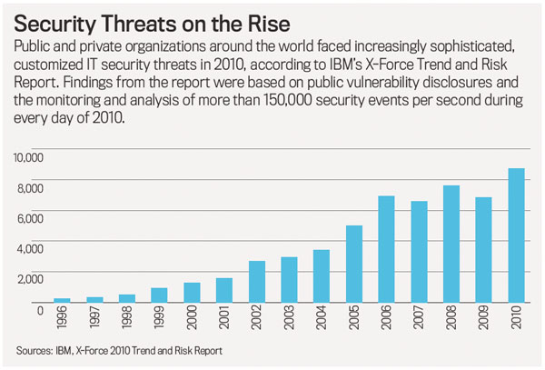
The State of Cybersecurity: Cyberattacks are on the Rise!

Slide 7
How Can We Improve the State of Cybersecurity? Our Mission.
  Produce security talent through top-notch security education.
  Work symbiotically with industry partners and professionals across different disciplines to advance cybersecurity research.
  Serve the broader community by promoting cybersecurity awareness and literacy.

Slide 8
Taking Initiative: The Strategy (1)
Goal 1: adapt an interdisciplinary approach to cybersecurity curriculum development:
  Computer Science: software, system, and network security.
  Electrical Engineering: security of the electrical grid systems.
  Civil Engineering: infrastructure security.
  Business and Information systems: Systems auditing, fraud-prevention/detection.
Goal 2: support and sponsor student and faculty research in cybersecurity:
  Funding opportunities for security research projects.
  Engage students in research.

Slide 9
Taking the Initiative: The Strategy (2)
Goal 3: Maintain symbiotic ties with industry partners:
  Solicit industry feedback guiding security curriculum development.
  Create security internship opportunities for students.
  Build a school-to-industry pipeline supplying industry partners with security talent.
  Encourage collaborative research projects between ECS faculty and industry professionals.
  Much more…

Slide 10
From Strategy to Tactics

Slide 11
Short-term Tactic 1
Expand existing curricula with new security courses in areas of thrust:
  Computer Science:
    Network Security
    (Network Security Fundamentals Course; offered Fall 2014 onwards)
    Distributed Systems and Cloud Security
    (Cloud Security Fundamentals; to be offered in Fall 2015).
    Computer Forensics
    (Work in progress: joint cooperation with Bechtel Corporation)
    Malware Analysis
    (Work in progress: joint cooperation with Bechtel Corporation)
    Virtualization Security
    Web Security
    Enterprise Security
    Security courses for non-majors
  Security courses in other ECS disciplines.

Slide 12
Short-term Tactic 2
Incorporate relevant security topics into non-security courses:
  Web development: XSS, SQL Injection, and RFI attacks/countermeasures.
  Operating systems: file system, memory, and process security.
  Computer Communications: ARP poisoning attacks, TCP prediction attacks, etc.
  Engineering courses: designing temper-proof hardware, physical security, security of medical devices, etc.
  All courses:
    Teach to avoid the mistakes of the past: design systems with security in mind!
    Emphasize high-impact pedagogical practices based on hands-on experience.

Slide 13
Short-term Tactic 3
Recruit faculty professionals qualified to teach and shepherd our curriculum:
  Cryptography
  Digital Forensics
  Distributed Systems Security
  BigData Security
  Trusted platforms
  Mobile Security

Slide 14


Short-term Tactic 4
Support student organizations:
  Offensive Security Society (Computer Science): professional group of students interested in cybersecurity.
  ISACA (Business/ISDS): a worldwide association of information security professionals dedicated to the audit, control, and security of information systems (CSUF chapter).

Slide 15
Long-term Tactics (1)
Tactic 1: establish undergraduate/graduate advising tracks in security.
Tactic 2: establish undergraduate/graduate degree programs in cybersecurity.
Tactic 3: establish a minor in security.
Tactic 4: establish vibrant, high-impact, externally funded security research agenda.

Slide 16

Long-term Tactics (2)
The Holy Grail: meet National Security Agency’s (NSA’s) criteria for becoming a nationally recognized center of excellence in security education!
Notes:
http://www.nsa.gov/academia/nat_cae_cyber_ops/nat_cae_co_criteria.shtml)

Slide 17
Questions?

