Slide 1
DATA PRIVACY EMERGING TECHNOLOGIES by Virginia Mushkatblat

Slide 2
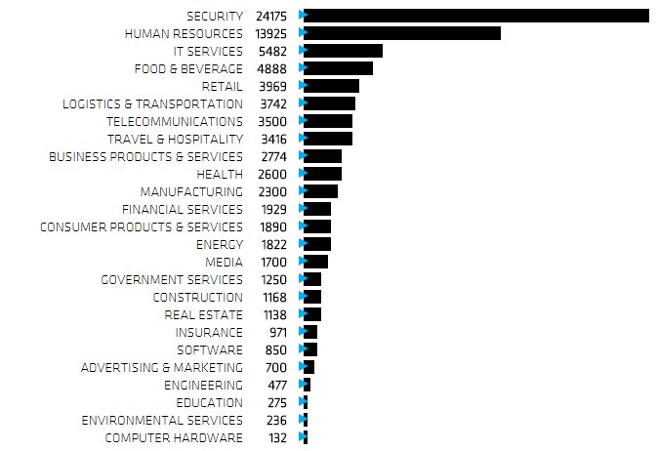
INC MAGAZINE FASTEST JOB CREATION CHART

Slide 3
WHY SECURITY?
JP MORGAN CHASE
TARGET
HOME DEPOT
SNAPCHAT
CSU
Healthcare.gov
LAST MONTH MEDICAL DATA BREACHES – DATA STOLEN BY INSIDERS
Memorial Hermann Hospital
AltaMed Health Services
Beachwood-Lakewood Plastic Surgery

Slide 4
THREAT CLASSIFICATIONS: WHO
EXTERNAL THREAT: STOLEN LAPTPS > THE HACKER ( insurance study)
malicious outsider (s)

Slide 5
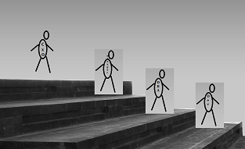
THREAT CLASSIFICATIONS: WHO part2
INTERNAL THREAT: THE THIEF
malicious outsider (s)
Insider’s trade
Selling PII on the
“black market”
Rare
Selling PII,
sabotage
CxO
Production user
DBA
Developer

Slide 6
THREAT CLASSIFICATIONS: WHO part3
INTERNAL / EXTERNAL COMBINATION THREAT: THE NAÏVE
The unintentional insider un-suspecting employees victims to fishing ; reckless abusers

Slide 7
THE COSTS
LIABILITY :
Target puts the costs at $148 million in the second quarter
REPUTATION : PUTTING ONESELF INTO VICTIM SHOES
NOTIFICATION LAWS
LESSER –KNOWN COSTS:
FINES
FTC ( minimum 10,000 fine for non-compliance in GLBA)
MONEY GRAMM experienced $100, 000 FINE
CA Supreme Court ruled Zip Codes are PII; $1000 per violation for retailers who ask for Zip code at point of sale
Auditing and insurance
Regaining good will (e.g. target credit monitoring)

Slide 8
TRADITIONAL SOLUTIONS: EXTERNAL THREAT
TRADITIONAL SOLUTIONS FOR OUTSIDER THREAT
Operations:
Firewalls • Network Monitoring Against DDOS • Anti Viruses
Development:
Encryption on different levels:
at Rest (symm, asymm)
in transit (ssl,tls)
Architectural decisions, or so called Privacy by Design:
use of stored procedures and proper use of encapsulation in code
Identity Access Management
More technical solutions plus LEGAL: PRIVACY LAWS

Slide 9
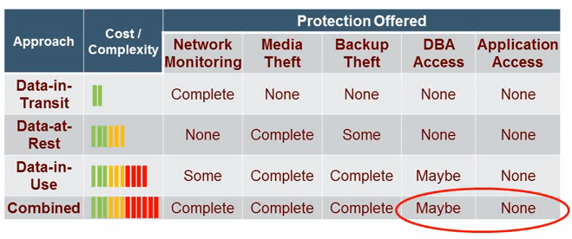
INTERNAL THREAT SOLUTIONS
ENCRIPTION
DATA MASKING
IDENTITY MANAGEMENT
AUDITS
Method | Media | Protects against Role
SDM | Disk –at rest | Developer, outsourcers
DDM | Application –in real time | Business Roles, third parties

Slide 10
EMERGING TECHNOLOGIES AND ARCHITECTURES
ANTI VIRUSES
Adaptive technologies
As the malware adapts so do the antivirus makers
Virtualizing: traffic or a page itself
AirGap. Virtualization of the page. It acts as a barrier against malware designed to get employees to click on an affected link

Slide 11
EMERGING TECHNOLOGIES AND ARCHITECTURES
SEPARATION OF CONCERNS:
Mask Me – separating the data from the entity
PEER-To-PEER
GOOGLE’s Two Steps Verification
two-step verification feature with Security Key, a physical USB second factor that only works after verifying the login site is truly a Google website.
Messenger and Notary server
Data masking : de-coupled algorithms, centralized audit reporting

Slide 12
Appendix: FRAMEWORK FOR DATABASE SECURITY
Establish legal base
Implement Identity and Access Management
Data discovery:
discover the databases and other storage
identify sensitive data
identify encryption method ( at-rest, in-transit, in-use)
identify roles-based masking requirements
Find out vulnerabilities
Fix privileges
Establish protection methods
Audit access, data, and transactions characteristics in real time
Establish notification and response systems
Do the drills
REACT!!!
Report the breaches

Slide 13
APPENDIX
FRAUD CLASSIFICATION
Wire and access device fraud:
unauthorized access to the bank accounts of customers
Identity theft:
steal identities,
facilitate the cash-out operations, including transferring money
making purchases,
file fraudulent tax returns with the IRS seeking refunds.
Other threats:
DDoS, Trojans
TECHNICAL KNOW-HOW:
stealing logins/passwords, reading of the networks traffic, Trojans, SQL injection, firewall penetration

