Slide 1
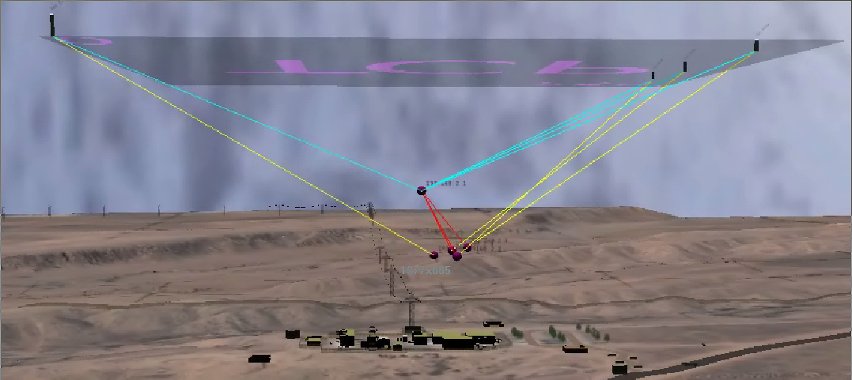
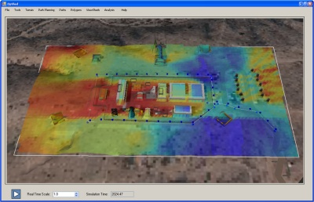
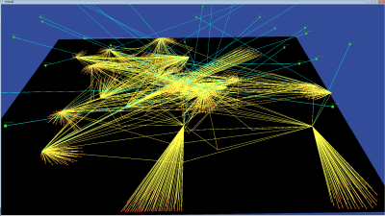
Cyber threats for our Nation: R&D to Active Defense
Thoughts about Cyber Security Programs
Michael Skroch (skraw)
14 Nov 2013

Slide 2
Intent for this talk…
I was asked to convey:
Background and thoughts in “cyber security”
Threats
My experiences
As a means to start a conversation.
Please participate! Ask questions & challenge.

Slide 3
A bit about my background for context
RIT, UW Madison
Sandia National Laboratories
NW Command & Control, Crypto, EMP/HEMP, Sensor Systems, International Programs, Cyber/Physical/Behavior, Red Teaming, Geospatial Modeling & Simulation, Serious Gaming, VP operations
DARPA
Information Assurance Science & Engineering Tools
$$$$
Pentagon, OSD C3I / NII
IA “go-fer” – Development of IA policy
No $
In my career, we have uncovered more questions than answers… There is a lot more to do!

Slide 4
A bit about Sandia’s background for context
DOE National Laboratory, see sandia.gov
GOCO, FFRDC
Multi-disciplinary lab
Science & engineering
Strong cyber security emphasis as a core mission
Long history in security and information security
Weapons
Systems
Physical
Security
Energy
Surety
Critical
Infrastructure
Homeland
Security
Nuclear
Surety
Use
Control
Systems
Analysis
Information
Surety
Information
Operations

Slide 5
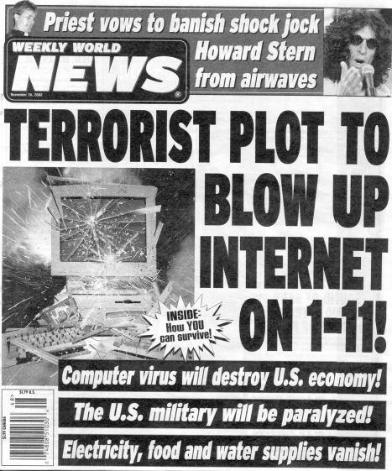
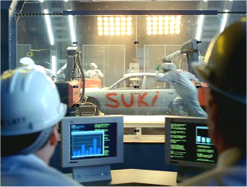
What is cyber security?
Motivation
Are we waiting for a cyber Pearl Harbor?
See “DARPA Vision Video” on youtube,
“Strategic Cyber Defense: Defending the Future in the Digital Domain”
http://www.youtube.com/watch?v=_h98gfLnuYE
EDS Suki video

Slide 6
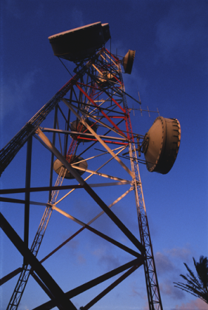
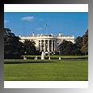
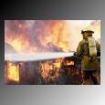
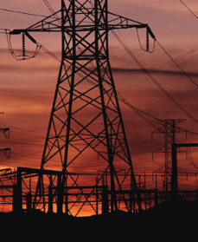
What is cyber security?
Motivation
Critical Infrastructures*
Industry relies on its own critical infrastructures elements (networks, etc.)
Industry relies upon domestic infrastructures
Oil & Gas
Continuity
of
Gov. Services
Water
Banking
&
Finance
Emergency
Services
Communica-
tions
Transpor-
tation
Electric
Power
* Infrastructures deemed to be so vital that their incapacity or destruction would have a debilitating regional or national impact or severely disrupt the behavior and activities of large numbers of people who depend upon the infrastructure

Slide 7
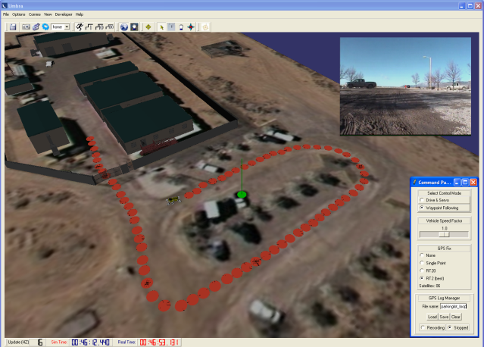
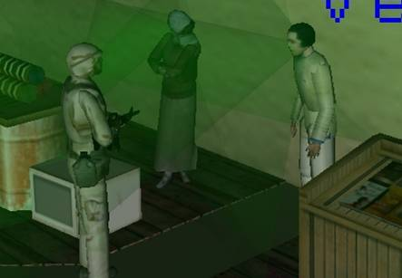
What is cyber security?
An effective cyber security approach is not just cyber…
Physical
Locations (x, y, z), volume
Environment
Physics / interactions
Behavior
Health, Mental state
Culture
Learning, memory
Perception
Decisions
Cyber
Human interactions
News media
Processing
Data at rest
Data in transit, communication
Integrity, Reliability, Security, Non-repudiation
Physical
Behavior
Worms
Viruses
Other Malcode
Phishing / Spear Phishing
Cyber

Slide 8
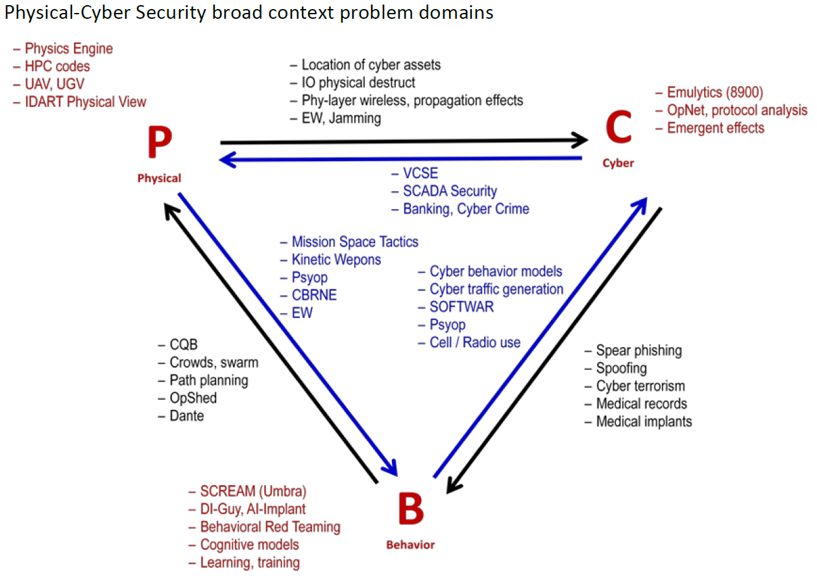
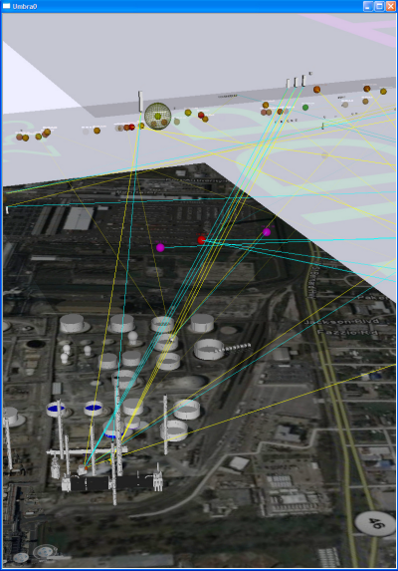
What is cyber security?
An effective cyber security approach is not just cyber…

Slide 9
What is cyber security threat?
Ourselves
Poor designs not considering threat
Think: Normal – Abnormal – Malevolent
Adversaries (Malevolent)
Economic
Nation-state
Terrorist

Slide 10
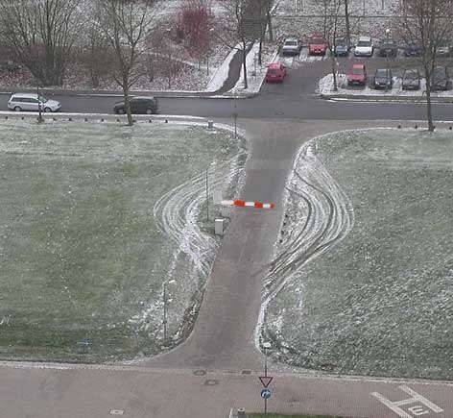
What is cyber security threat?
An effective cyber security program includes thinking like the bad guy
Red Teaming – an adversarial-based assessment
Why?

Slide 11
What is cyber security threat?
A bad guy will think below your level of abstraction or in-between your system interfaces
Physical
…
World
Continent
Country
State
City
Campus
Buildings
Rooms
Objects
Components
Subcomponent
Connections
Channels
Chemicals
Molecules
Atoms
Subatomic
…
Behavior
…
DNA
Culture
Movements
Clan
Family
Group
Person
Mental state
Emotion
Memory
…
Cyber
…
Internet
Archive
Data center
Info state
Document
Concept
Protocol
Word
Byte
Bit
…
Conceptual Scales

Slide 12
What is cyber security?
An effective cyber security approach will embrace rapid change as a leverage point for success.
An effective cyber security program will include simulation and hands-on activity.
An effective cyber security approach …
What “effective means is differentiating for the University?

Slide 13
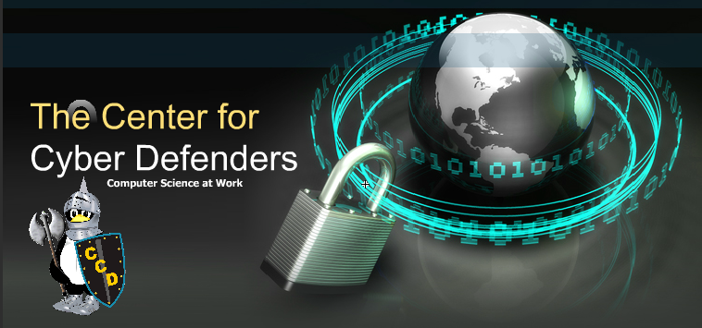
A few Sandia websites
Center for Cyber Defenders
http://www.sandia.gov/ccd/

Slide 14
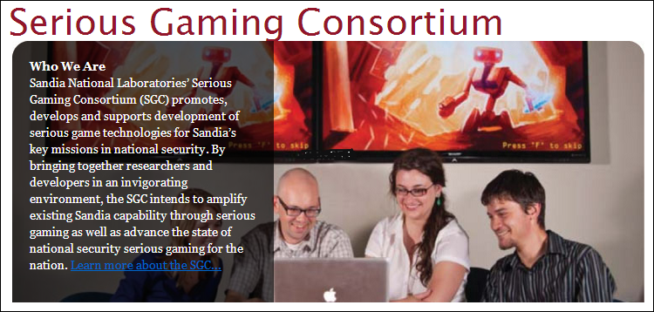
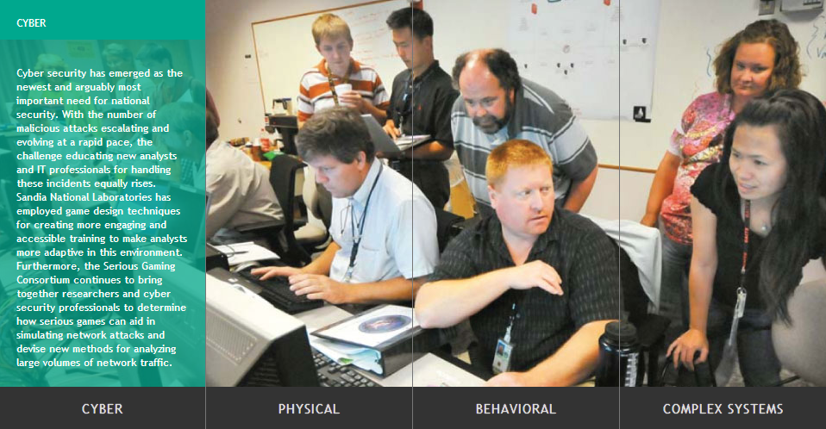
A few Sandia websites
Serious Gaming Consortium
http://sg.sandia.gov/

Slide 15
Discussion?

