Slide 1
Urgent Issues in Cyber Security:
Preliminary Cyber Security Framework (PCSF) …
How secure are Cyber Physical Systems?
Ron Williamson, Ph.D.
Senior Engineering Fellow
Raytheon
November, 2013

Slide 2
Agenda –
Urgent Issues in Cyber Security: Energy Surety
Introduction
  Context Setting for Energy Surety…Physical vs Cyber, what’s the difference
  Energy Infrastructure Threats and Urgent Issues
  Relationship with Resiliency and Resilient Systems Engineering
Case Studies on Cyber Attacks
  A – Stuxnet
  B – Duqu
  C – Flame
  B – Gauss
So…How do we defend against these attacks?
  DHS Advice to Critical Infrastructure Owners
  Threat assessment tools and techniques
  Vulnerability Analysis tools and techniques
Research Conclusions, Recommendations and Q&A
Electrical Power is Critical: Without it , you’d have to do your homework (and watch TV) by candle light (& batteries)

Slide 3
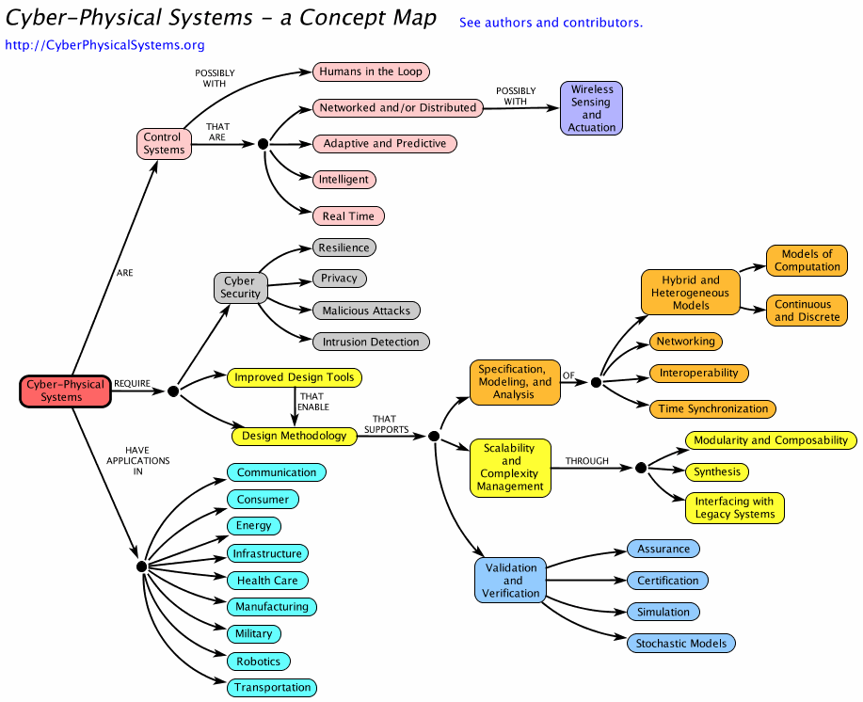
What are “Cyber Physical” Systems?

Slide 4

Preliminary Cyber Security Framework (PCSF) Introduction & Context
The national and economic security of the United States depends on the reliable functioning of critical infrastructure.
  Financial Systems
  Transportation Systems
  Energy Systems
  Educational Systems
  Electronic Commerce
Presidential Executive order 13636 (February 12, 2013)
  “Improving Critical Infrastructure Cyber Security”
  Calls for a Cyber Security Framework to provide
    “prioritized, flexible, repeatable, performance-based and cost-effective approach” to manage cyber Security risk.
  Defines critical infrastructure as
    “systems and assets, whether physical or virtual, so vital to the US that the incapacity or destruction of such systems and assets would have a debilitating impact on security, national economic security, national public health or safety or any combination of those matters”

Slide 5
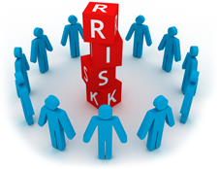
PCSF Introduction & Context
What is the “framework”?
  Developed in collaboration between government and industry
  Provides guidance to an organization on managing cyber security risk
  Similar risk assessment approach as used to determine financial, safety or operational risk
Note the key word here is RISK
  As with any other potential risk, the ability to mitigate or
  eliminate the risk is driven by several factors
    Impact of the effects of the risk factor
      Including human safety, financial loss, degradation of performance
    Costs associated with the impact and the costs associated with mitigating the risk
For example, in the financial industry the risk associated with credit card fraud
  To eliminate fraud entirely would cost more than the losses associated with fraud
  The industry has chosen a “middle ground” that accounts for a “small percentage” of fraud to occur, but minimizes the inconvenience to credit card customers (e.g. freeze account, re-issue a new credit card, absorb $$ loss for customer)

Slide 6

PCSF Implementation Tiers
Framework Implementation Tiers describe the maturity of risk management an organization chooses to apply to each category of action/activity.
The tiers include
    partial,
      risk-informed,
        repeatable, and
          adaptive levels,
    with the “adaptive” tier denoting the best developed risk management procedures
Adaptive
Increasing maturity/sophistication
Repeatable
Risk Informed
Partial
  Source: http://www.nist.gov/itl/upload/discussion-draft_preliminary-cybersecurity-framework-082813.pdf

Slide 7
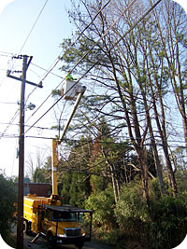
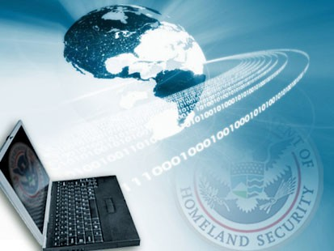
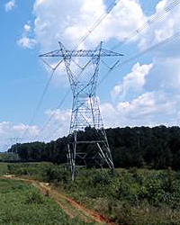
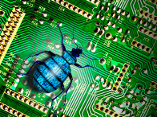
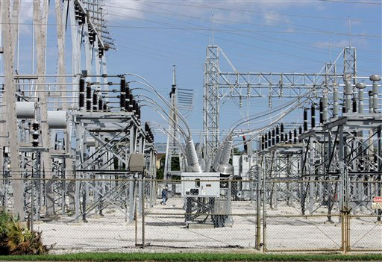
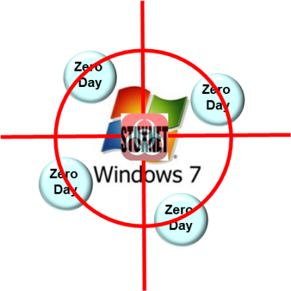
Urgent Issues in Cyber Security:
Energy Surety

Slide 8
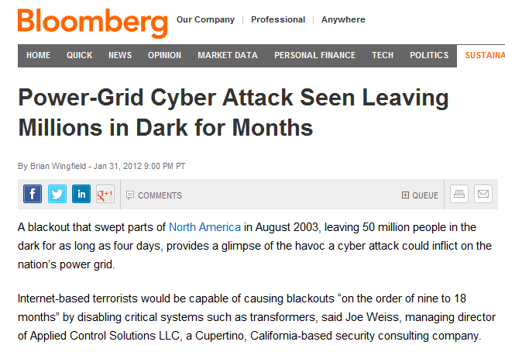
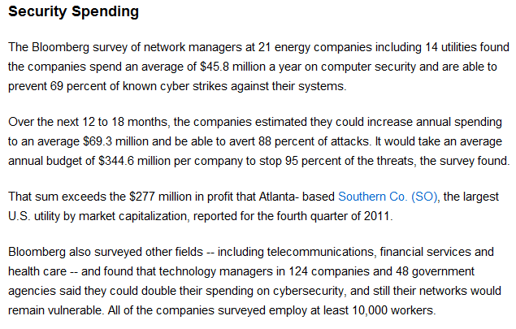
Energy Surety:
The Problem and the Opportunity
$$$
…computer security…
annual budget of $344.6M per company
to stop 95% of threats
…causing blackout
“on the order of nine to 18 Months”
Performance

Slide 9

Context Setting for Energy Surety…
Physical vs Cyber Threat, what’s the difference
2102 CSUF ECS Breakfast Topic addressed
  Bolts, Jolts & Volts: Ensuring Reliability in Electrical Transmission
  The talk focused on some key outages and root causes
    2003 NE/Canada Outage 55 Million people affected
    2011 So Cal/Arizona/Baja Outage 1.5+ Million people affected
    2012 India Outage 680 Million people affected
Weather: 1,229
Faulty equipment or human error: 767
Vehicle accident: 245
Animal: 208
Planned: 138
Theft or vandalism: 28
Reveals vulnerabilities in the electric power grid that can be exploited by the Cyber Attacker
Source: from Eaton Corp., a private power management company that publishes an annual "Blackout Tracker."

Slide 10
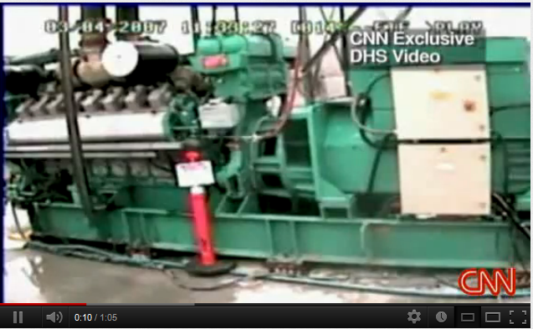
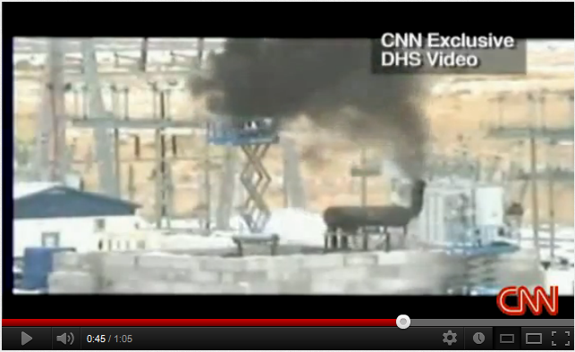
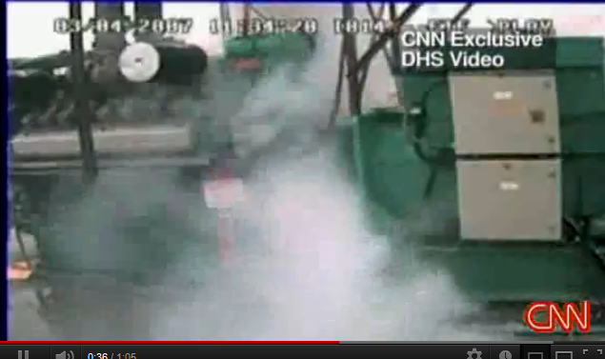
  Energy Infrastructure Threats and Urgent Issues
Overall Threat
  Increasing government concerns about the little-understood risks of cyber attacks on specialized electronic equipment that controls operations in power and water utilities, and chemical plants.
Some issues
  Department of Homeland Security demonstrated a simulated hacker attack on the computer system controls of a power generator (see Safety Issues article, Sept. 29, 2007).
  In the test, the big generator shook violently, belched smoke, flew apart and was rendered inoperable.
  The test showed a dangerous weak point in the supervisory control and data acquisition systems of U.S. utility companies.
http://www.youtube.com/watch?v=fJyWngDco3g
Source: http://www.safetyissues.com/site/cyber_crime/cia_reveals_hacker_attacks_on_utilities.html

Slide 11
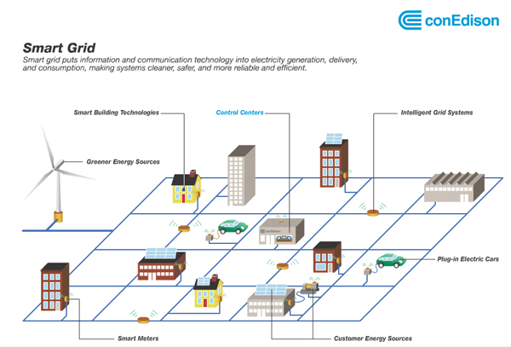
  Emerging Trends:
  A Convergence of Smart Grid Needs and Cyber Capabilities
What is a smart grid?
Puts information and communication technology into electricity generation, delivery, and consumption
Makes systems cleaner, safer, and more reliable and efficient
How will customers benefit from smart grid?
Increased reliability
Added capacity through increased system efficiency
Reduced outage response time
Reduced operating and maintenance costs.

Slide 12
What Would a Power Grid Cyber Attack Look Like?
CIA Reveals Hacker Attacks on Utilities
  The hackers demonstrated the ability to cause blackouts that affected multiple cities.
  In most cases there were demands for extortion payments before the power was cut off.
  The cyber attacks all took place outside the U.S. but the CIA did not specify the countries affected, when the incidents occurred, the amount involved, or the duration of the outages.
  The CIA had reason to believe that in some cases the hackers possessed inside knowledge.
  All of the attacks were made through the Internet, though as with the Stuxnet worm, even “disconnected” systems can be attacked
What kinds of Cyber Attacks and Who is the Source?
  Viruses, Worms, Trojan Horses, Blended Threats
  Nation states, terrorist cells, criminal gangs, individual hackers, etc.

Slide 13

Some Cyber Attack Mechanisms
Virus
  Attaches itself to a program or file enabling it to spread from one computer to another, leaving infections as it travels.
  Can range in severity: some may cause only mildly annoying effects while others can damage your hardware, software or files.
Worm
  Similar to a virus by design and is considered to be a sub-class of a virus.
  Spread from computer to computer, but unlike a virus, it has the capability to travel without any human action.
  Takes advantage of file or information transport features on your system, which is what allows it to travel unaided.
Trojan Horse
  Will appear to be useful software but will actually do damage once installed or run on your computer.
  Trojan Horses usually trick users into opening them because they appear to be receiving legitimate software or files from a legitimate source.
Blended Threat
  A more sophisticated attack that bundles some of the worst aspects of viruses, worms, Trojan horses and malicious code into one single threat.

Slide 14
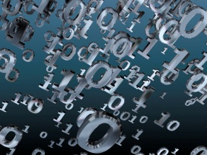

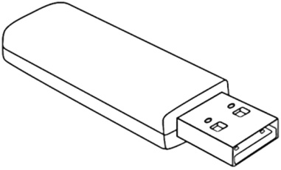


What Would a Power Grid Cyber Attack Look Like?
Case Studies of Cyber Attacks
  Stuxnet
  Flame
  Gauss
  Duqu
Cyber Attack Vectors
Online
Offline
email
www
0-day vulnerability
file download
Denial of Service
port scanning

Slide 15
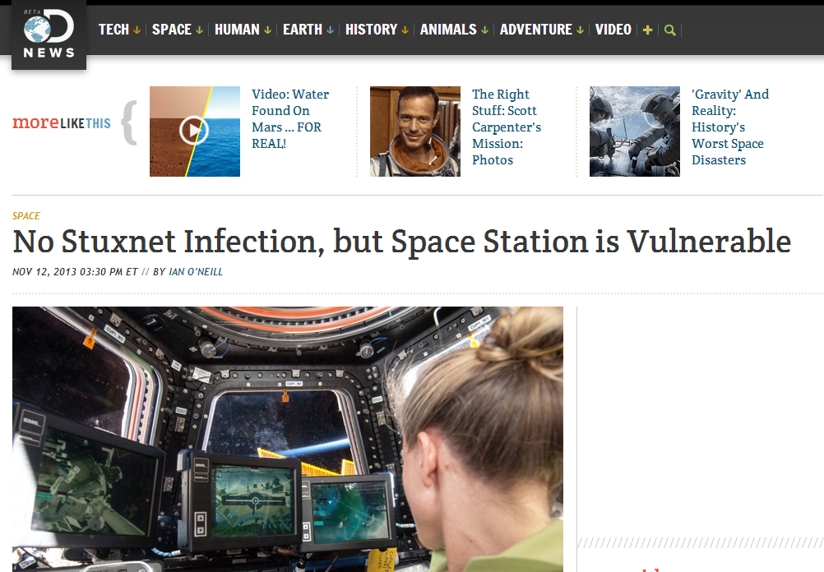
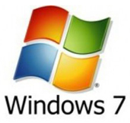

Case Study A
Stuxnet
Zero
Day
Zero
Day
Zero
Day
Zero
Day

Slide 16
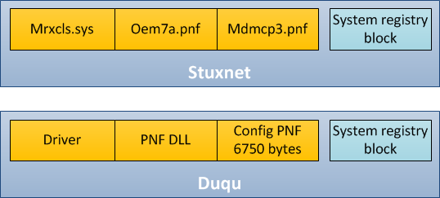
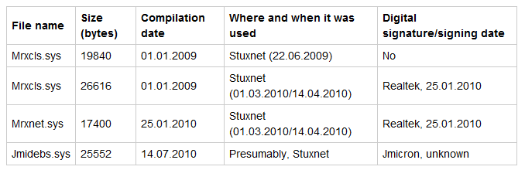
Stuxnet: What is it?
It is characterized as a worm
Targets PLC/SCADA equipment
  PLC – Programmable Logic Controller , used as field devices replacing remote terminal units that attach to sensors monitoring industrial processes
  SCADA – Supervisory Control and Data Acquisition, a type of industrial control system used in Electrical Power Systems, manufacturing, production, fabrication, refining, etc.
Same architecture platform used to create Stuxnet & Duqu
Contains
  Driver file which loads a main module
  designed as an encrypted library
  Configuration file
  Encrypted block in the system
  registry
  Definition for the location of the
  module being loaded and the
  name of the process for injection
Drivers

Slide 17
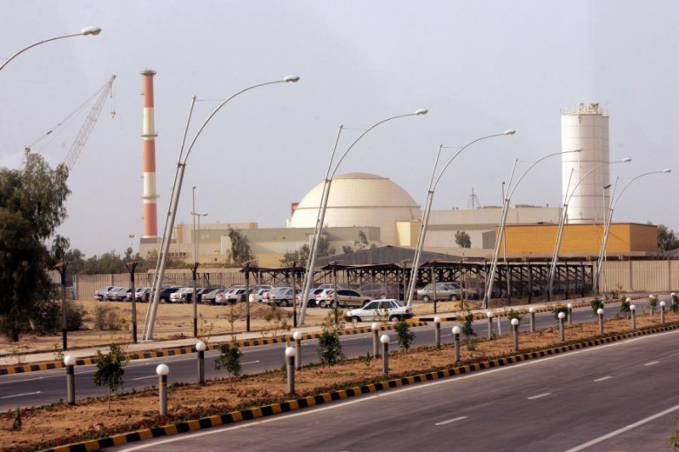



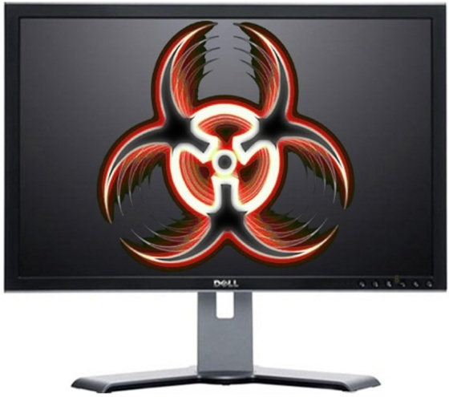
Stuxnet: How it Worked
Nuclear facility in Iran has no connections to the Web, making it secure from outside penetration
Stuxnet was designed and sent into the area around the nuclear power plant to infect a number of computers
  – Assumption: someone working in the plant would take work home on a flash drive, acquire the Stuxnet worm, and then bring it back into the facility

Slide 18


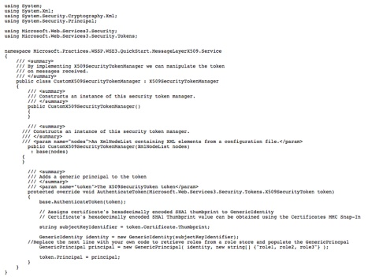
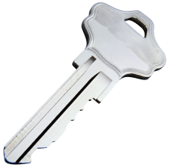
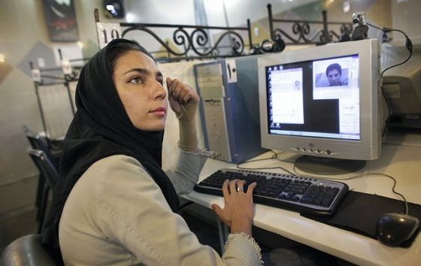

Stuxnet: How it Worked
Once inside the facility, the worm required trust from the computer system to allow it in
– The worm contained a stolen, trusted “digital certificate”

Slide 19
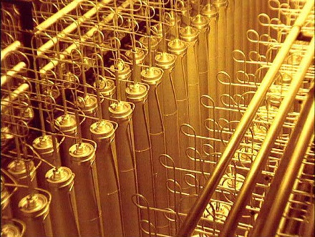
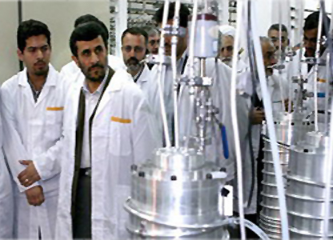

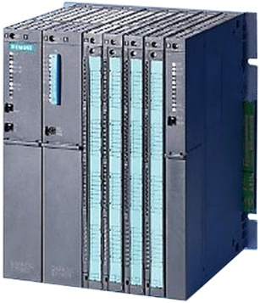
Stuxnet: How it Worked
Once allowed entry, the worm contained four “Zero Day” elements in its target, the Windows 7 operating system, that controlled the overall operation of the plant
  – Zero Day elements are rare and extremely valuable vulnerabilities in a computer system that can be exploited only once
Zero
Day
Zero
Day
!
Zero
Day
Zero
Day
Siemens
Operating System
Centrifuges
Unhappy Customer
Frequency
Converters

Slide 20
So… how do we defend against these attacks?

Slide 21
Threat Assessments
How to Assess Threats
  Threat = Capability + Intent + Opportunity
  Assumes existence of a “Threat Actor”
    US-CERT: National governments, terrorists,
    industrial spies, organized crime groups, hacktivists, hackers
  Estimate the attackers potential capabilities
Understanding threats is an age old dilemma
  Son Tzu quote: "…if you know your enemies and know yourself, you will fight without danger in battles…“
Asymmetric Threats
  A single individual, with minimal
  cost & resources can wreak havoc
  Attack vectors: via networks, via peripherals,
  via supply chain, etc.
  Root cause methods…find the attackers,
  their infrastructure, their locations, their intent,
  their weaknesses, the underlying technologies
  Cyber Threat Profiles & Models:
  Metrics, Attributes, Matrices, Correlations, Attack Trees, Ranking, etc.
Sources: Idaho National Laboratory, Asymmetricthreat.net, www.fas.org

Slide 22
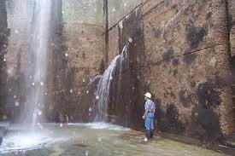
Vulnerability Assessments
A Vulnerability Assessment discovers,
vulnerabilities susceptible to known exploits
that pose varying levels of risk to the
organization.
Standards & Methodologies include
  OSSTMM – Open Source Security Testing
  Methodology Manual
  DIACAP – DoD Information Assurance Certification
  and Accreditation Process
  NIST SP 800-53 – Security Controls for Federal Information Systems & Organizations
  Mitre – Cyber Threat Susceptibility Assessment (TSA)
Current, emerging 0-day and past threats vulnerability signatures including,
  Missing security service packs,
  Buffer/heap overflows,
  Local and remotely exploitable vulnerabilities,
  Default accounts, backdoors and trojans,
  Conditions leading to denial of service attacks,
  The presence of rootkits or network hacking tools, and
  Firmware vulnerabilities for networked devices

Slide 23
Conclusions & Recommendations
The Cyber Threat on the Energy Infrastructure is real and growing
It is a Global and National Security issue that requires strategy and tactics for a layered, in-depth defense
We need to invest in several areas
  Threat Assessment -- continue to search for and analyze the evolving threats
  Cyber Defense -- intrusion detection and prevention technologies
  Smart Grid Security – as we move forward in modernizing
  our Energy Infrastructure make Cyber Defense
  a high priority in the engineering tradeoffs

Slide 24


